Slide 1
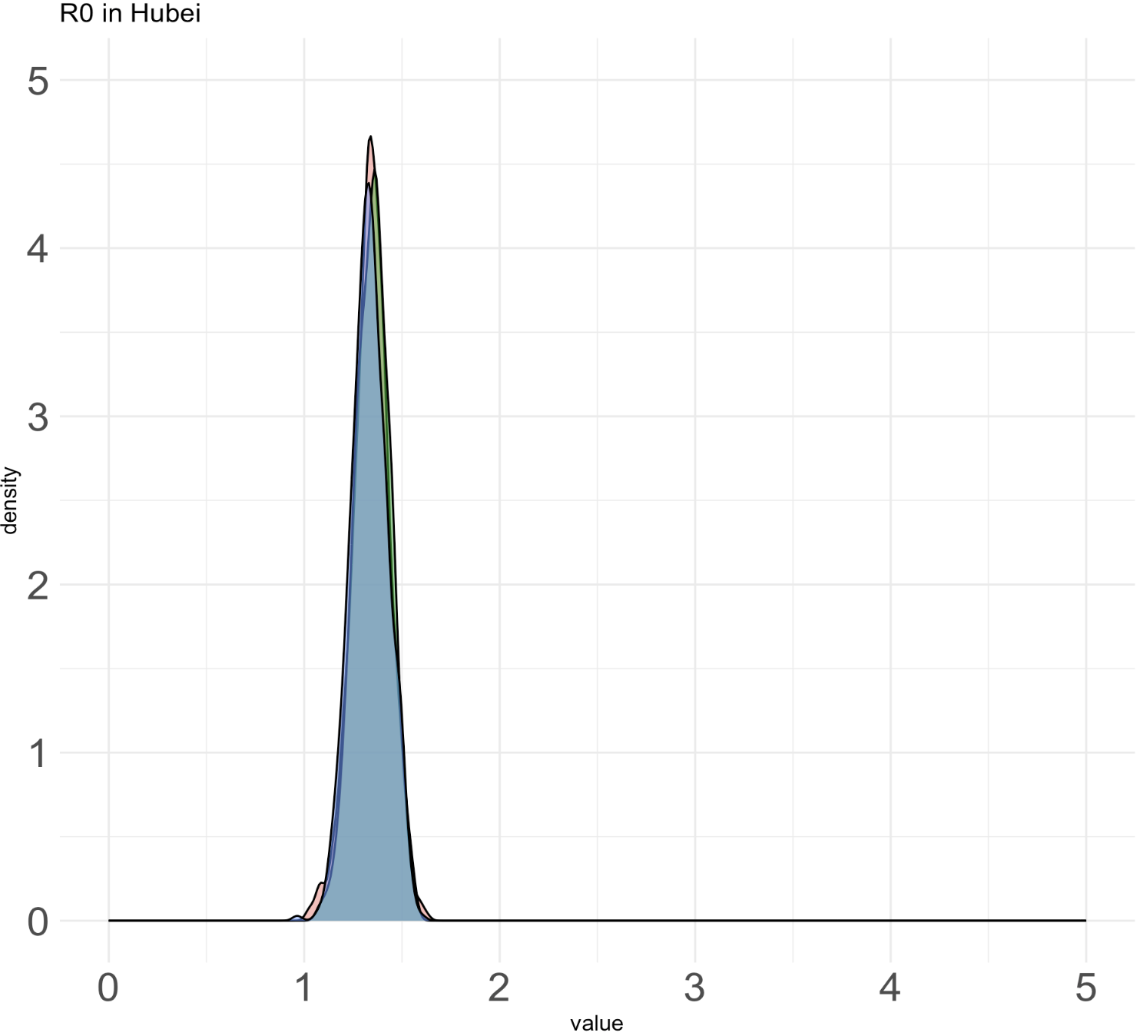
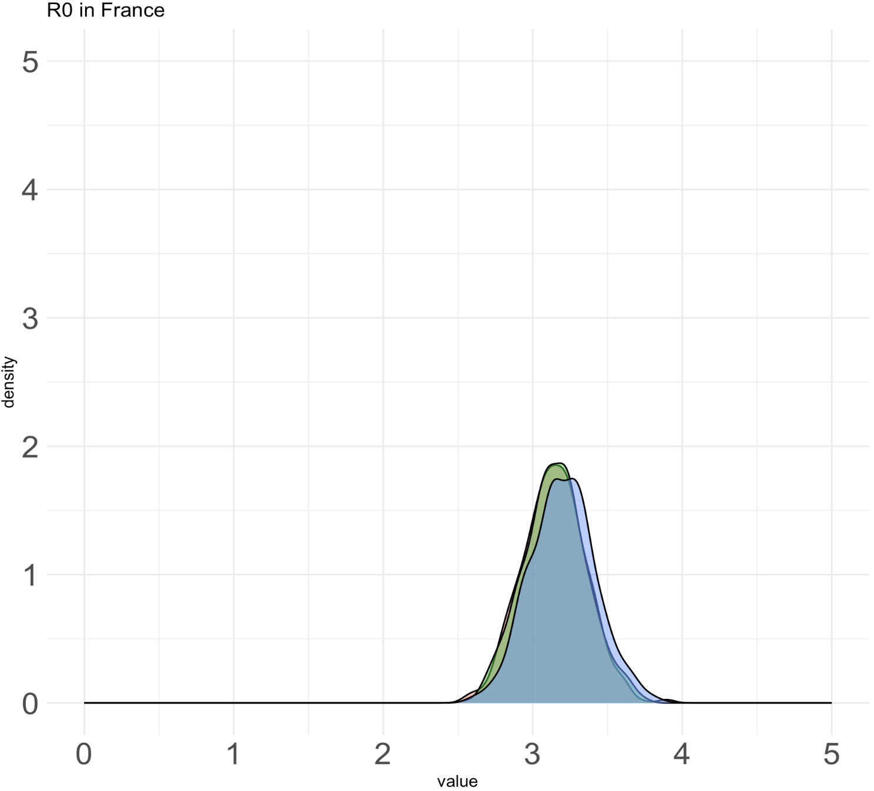
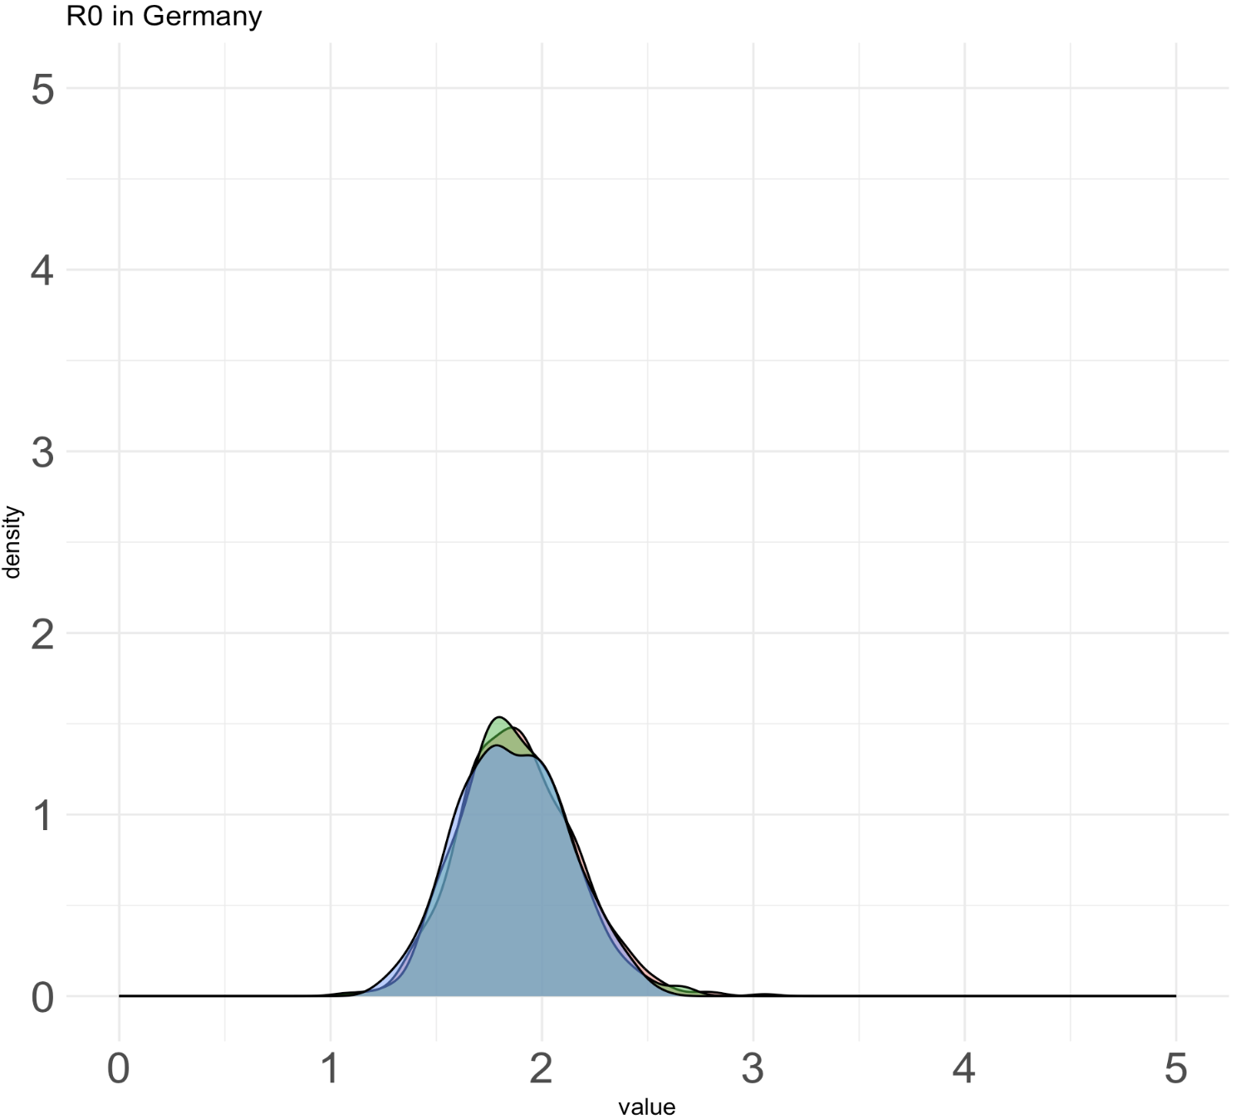
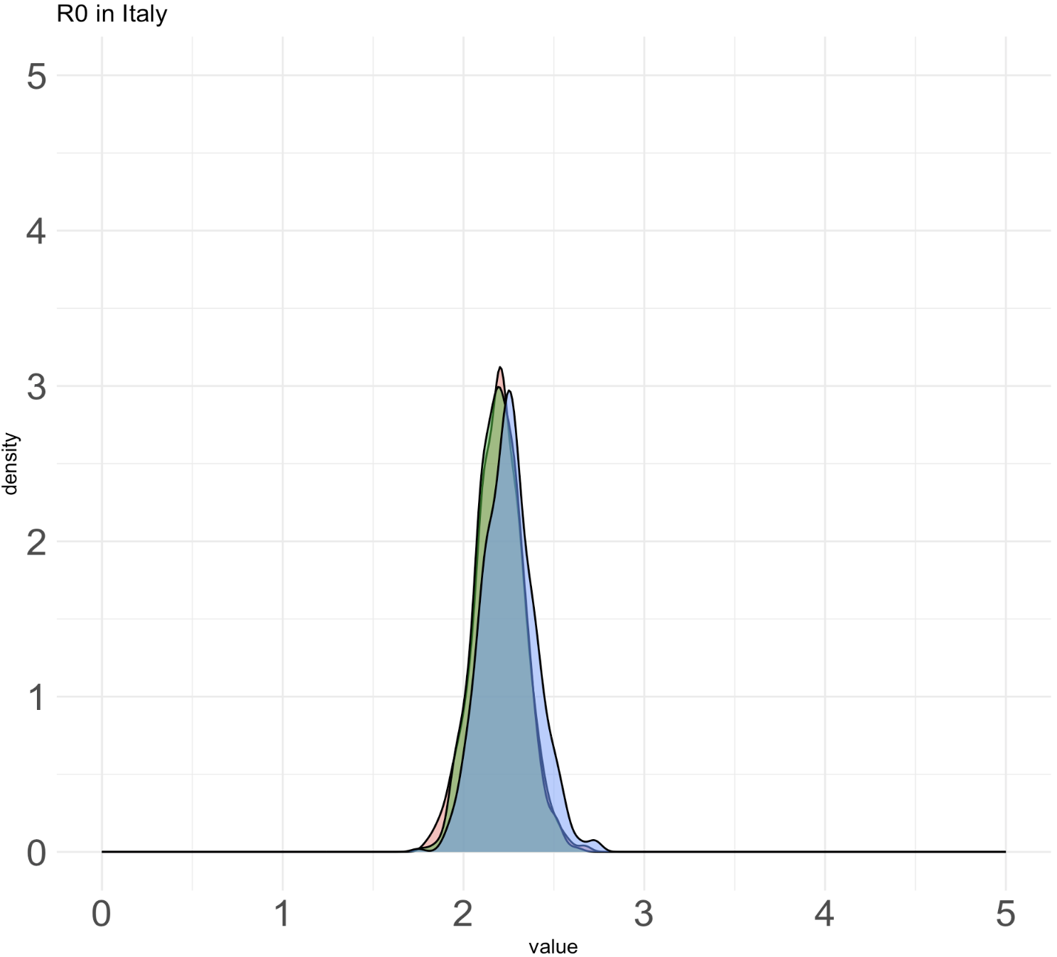
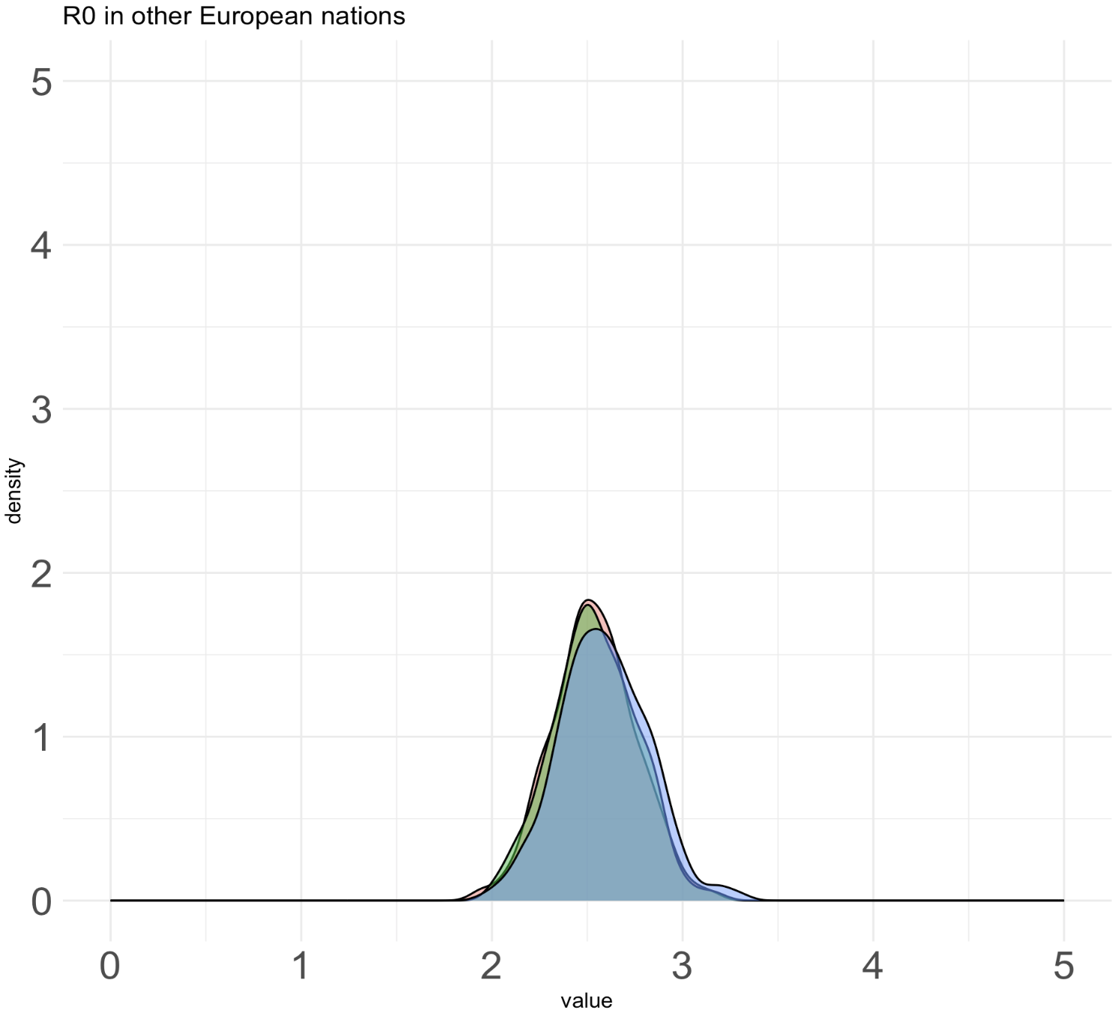
Equal rates model (new priors on sampling proportions and empirical priors)

Slide 2
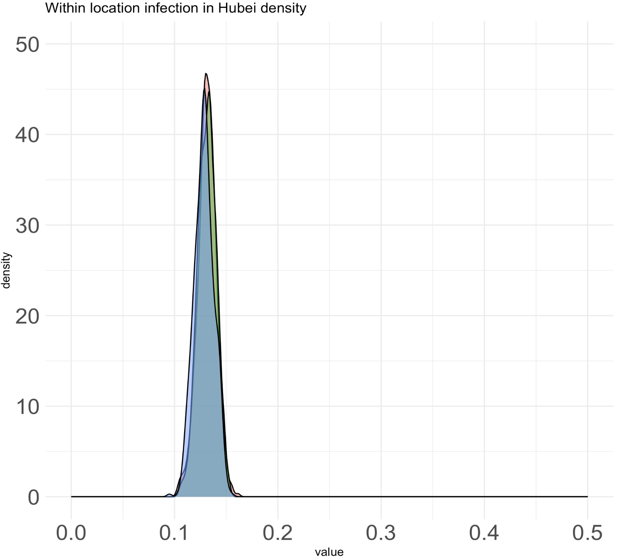
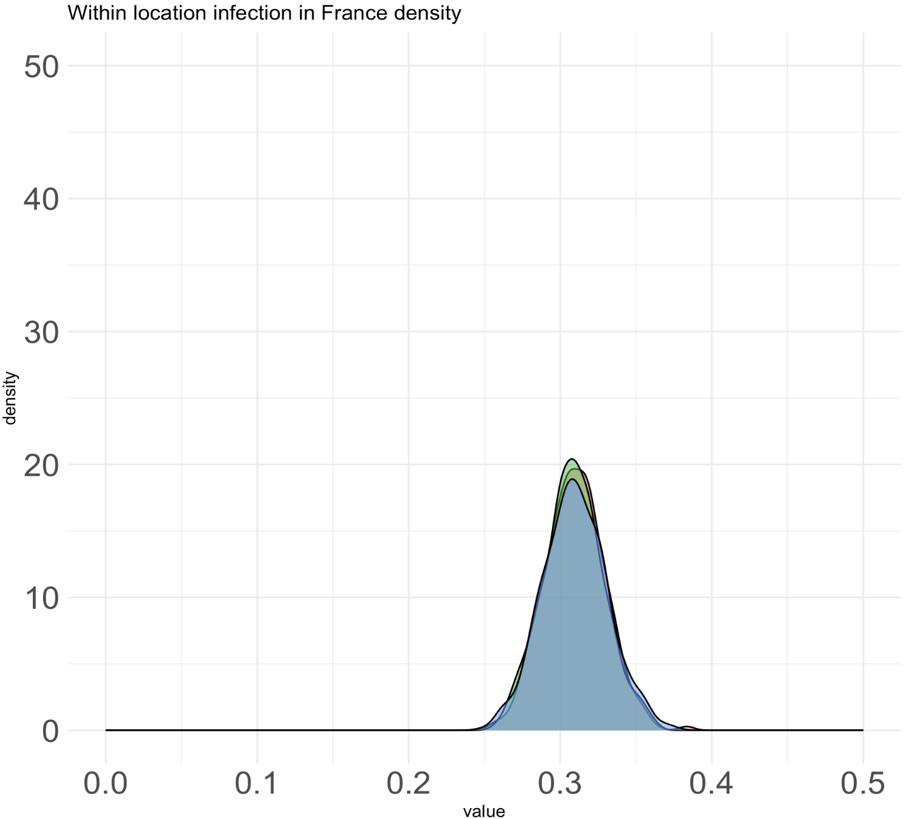
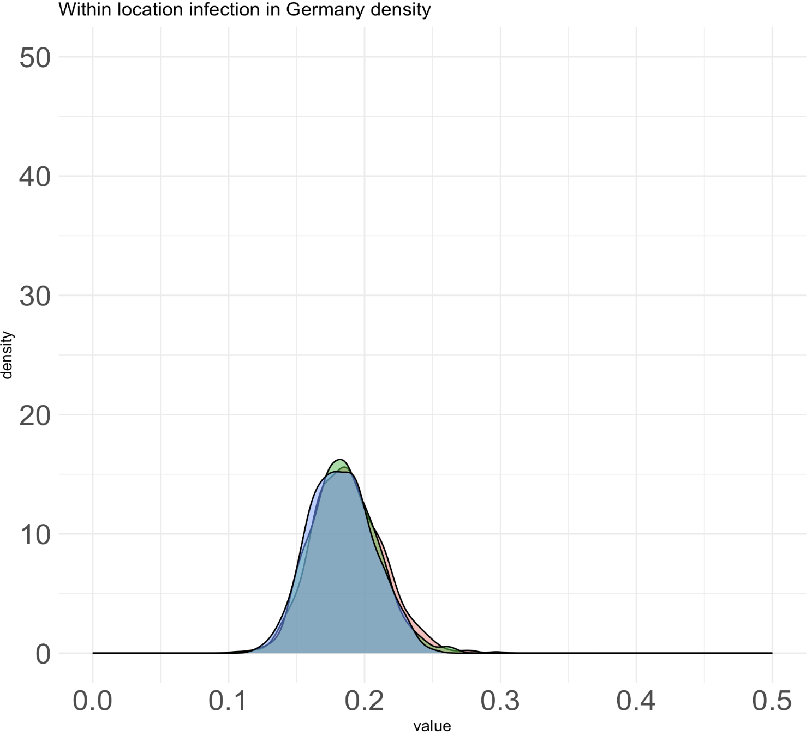
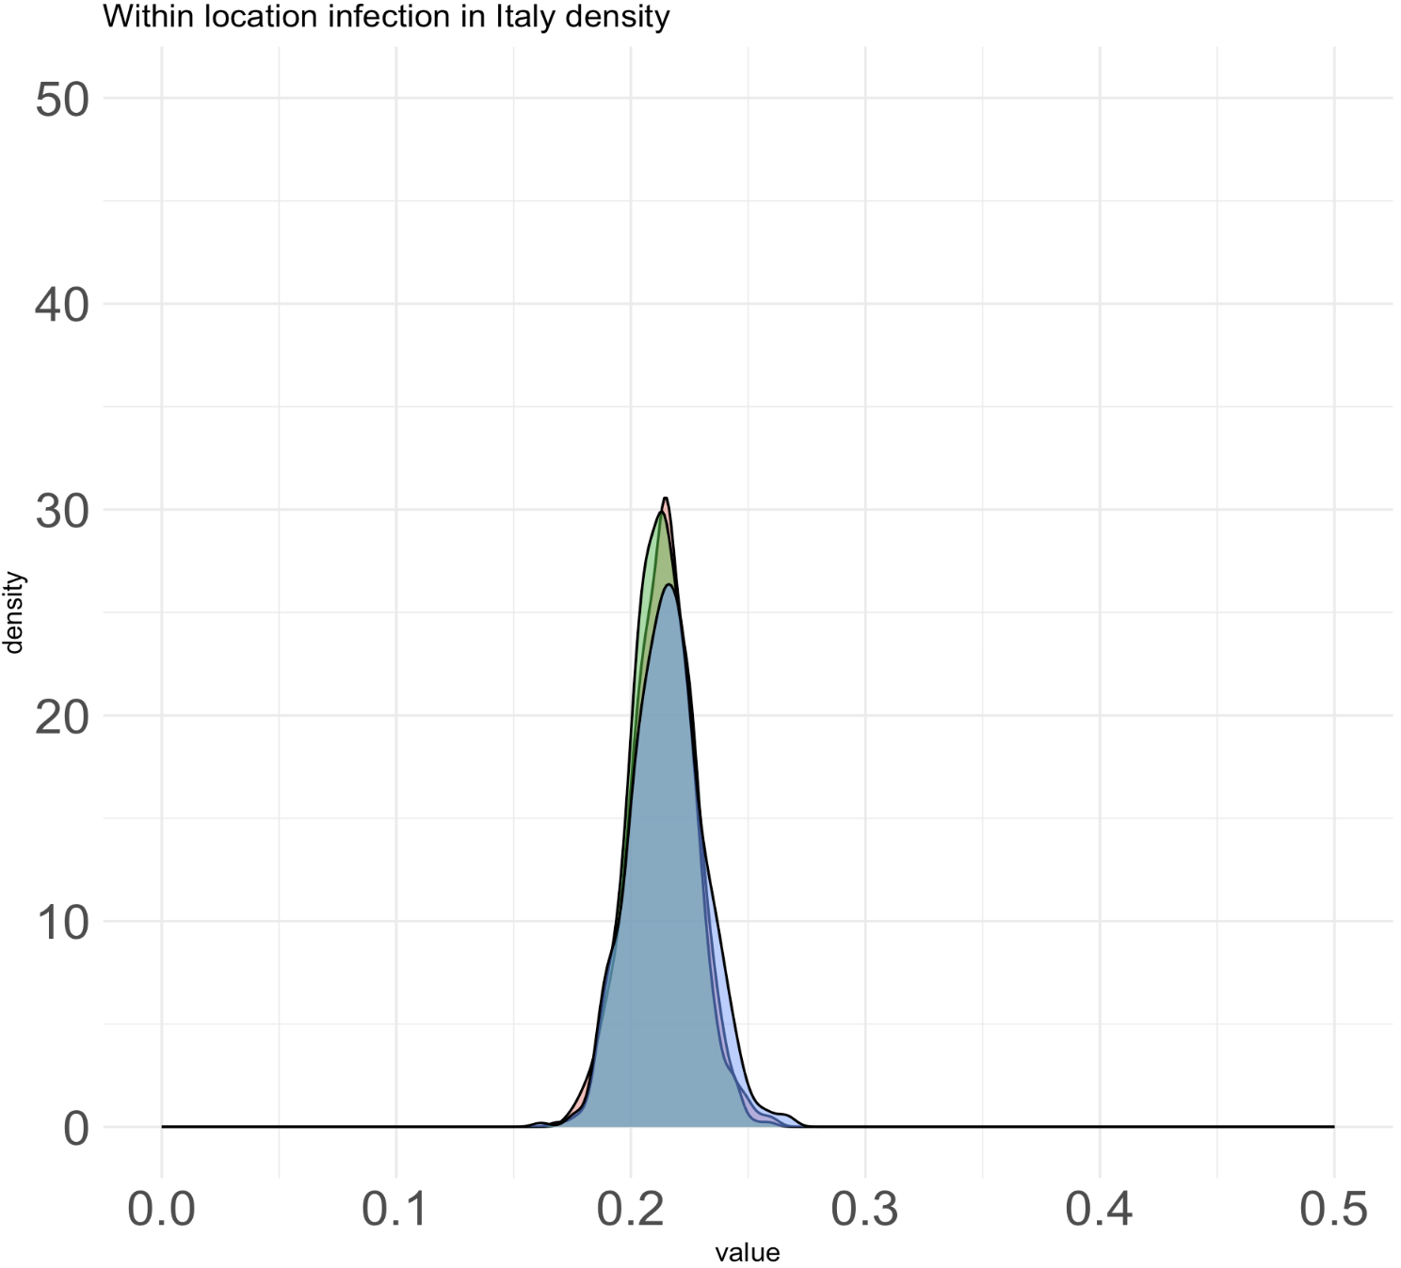
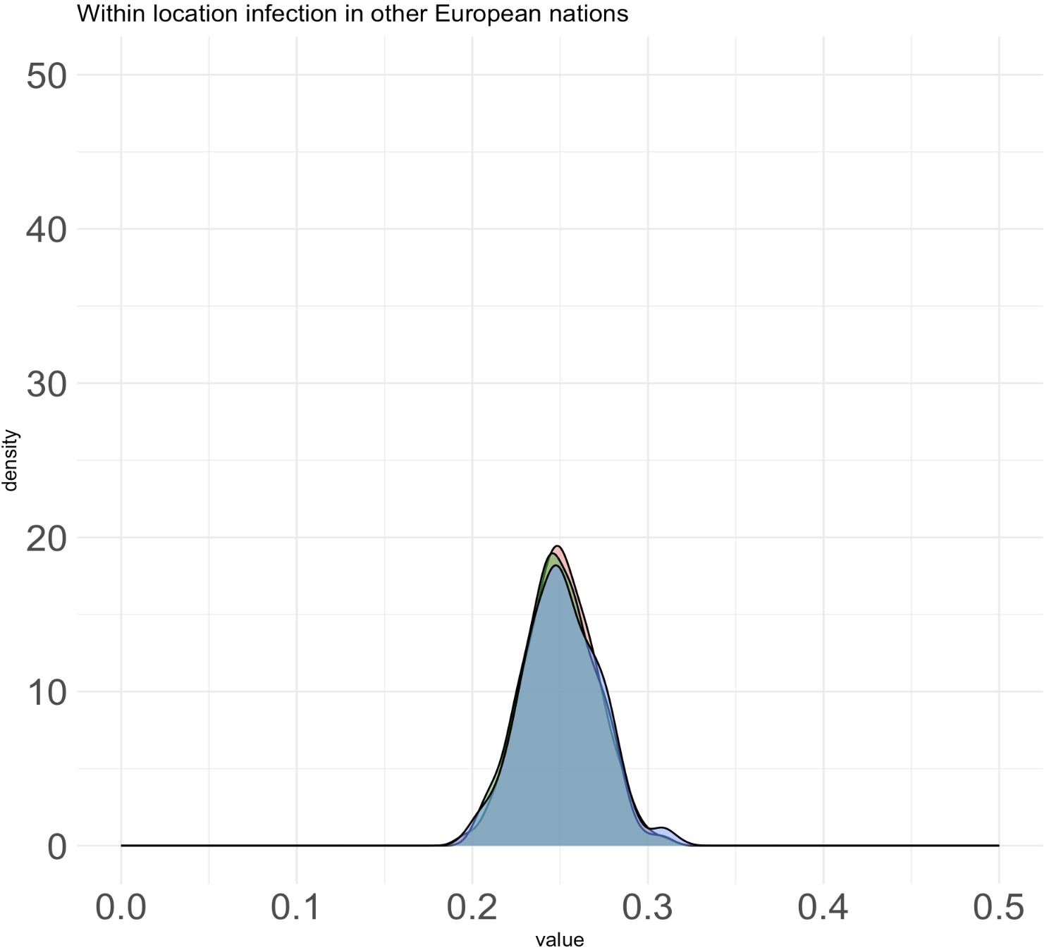
Equal rates model (new priors on sampling proportions and empirical priors)

Slide 3
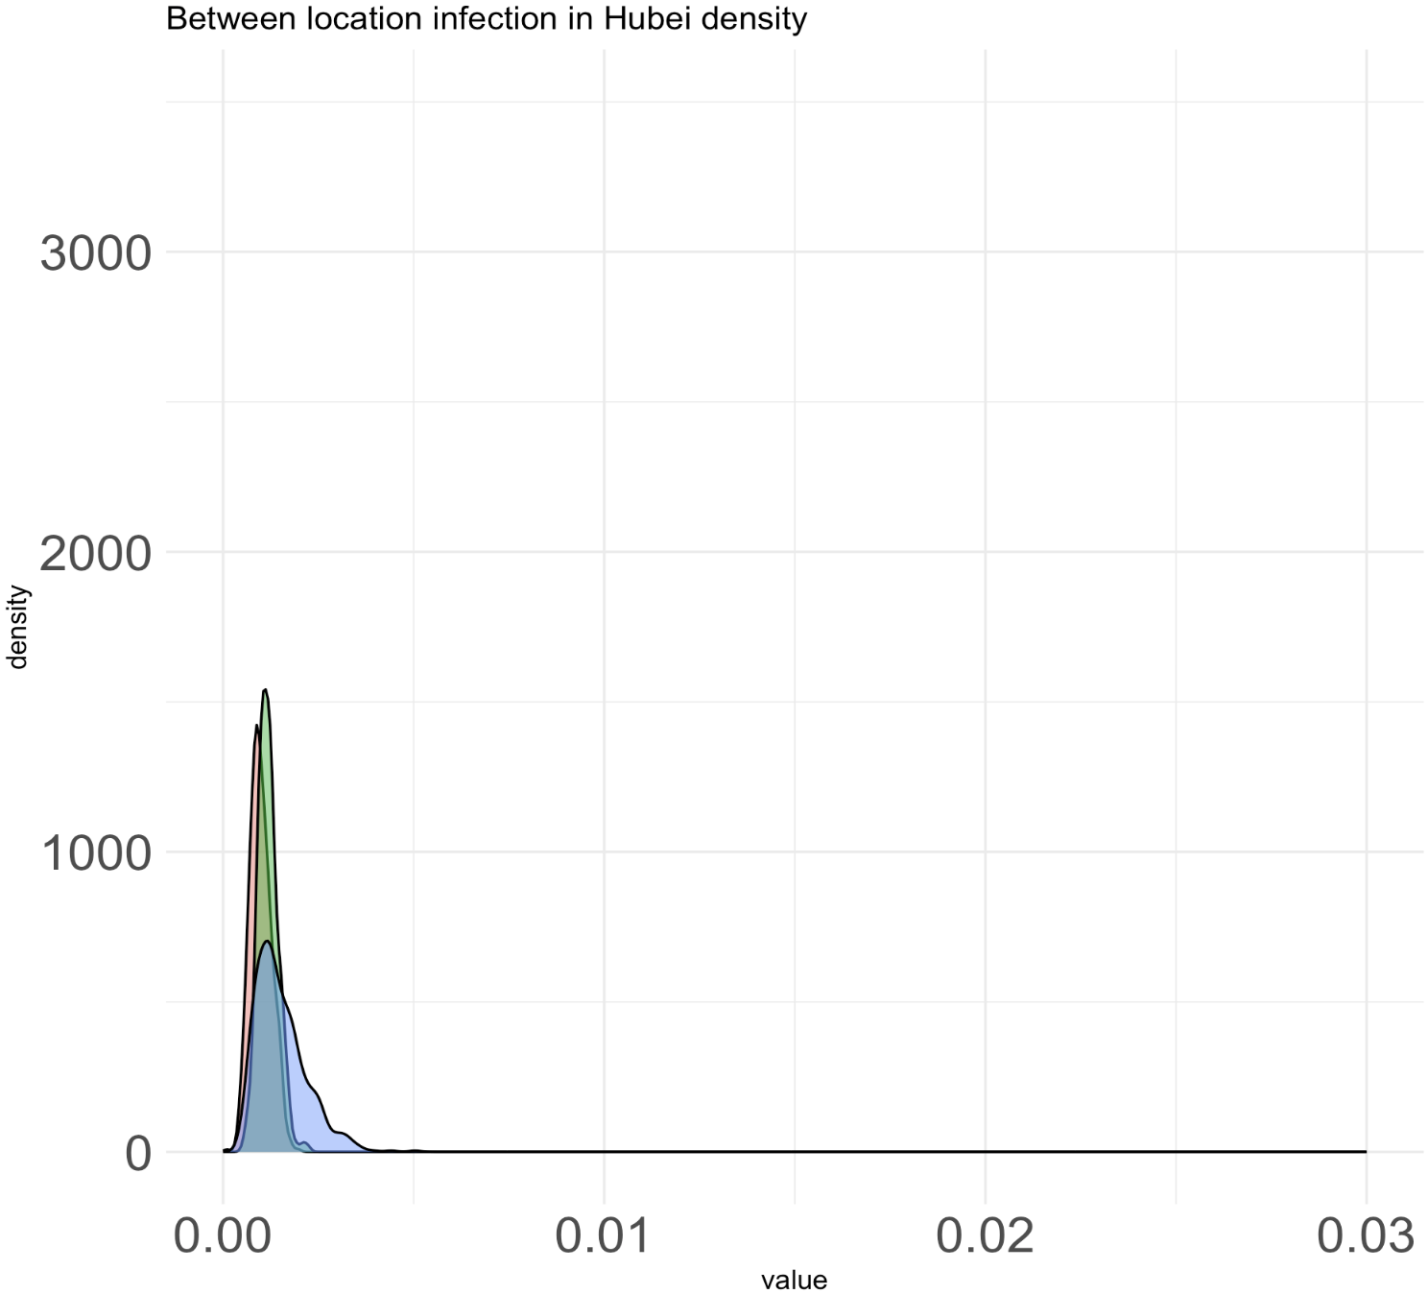
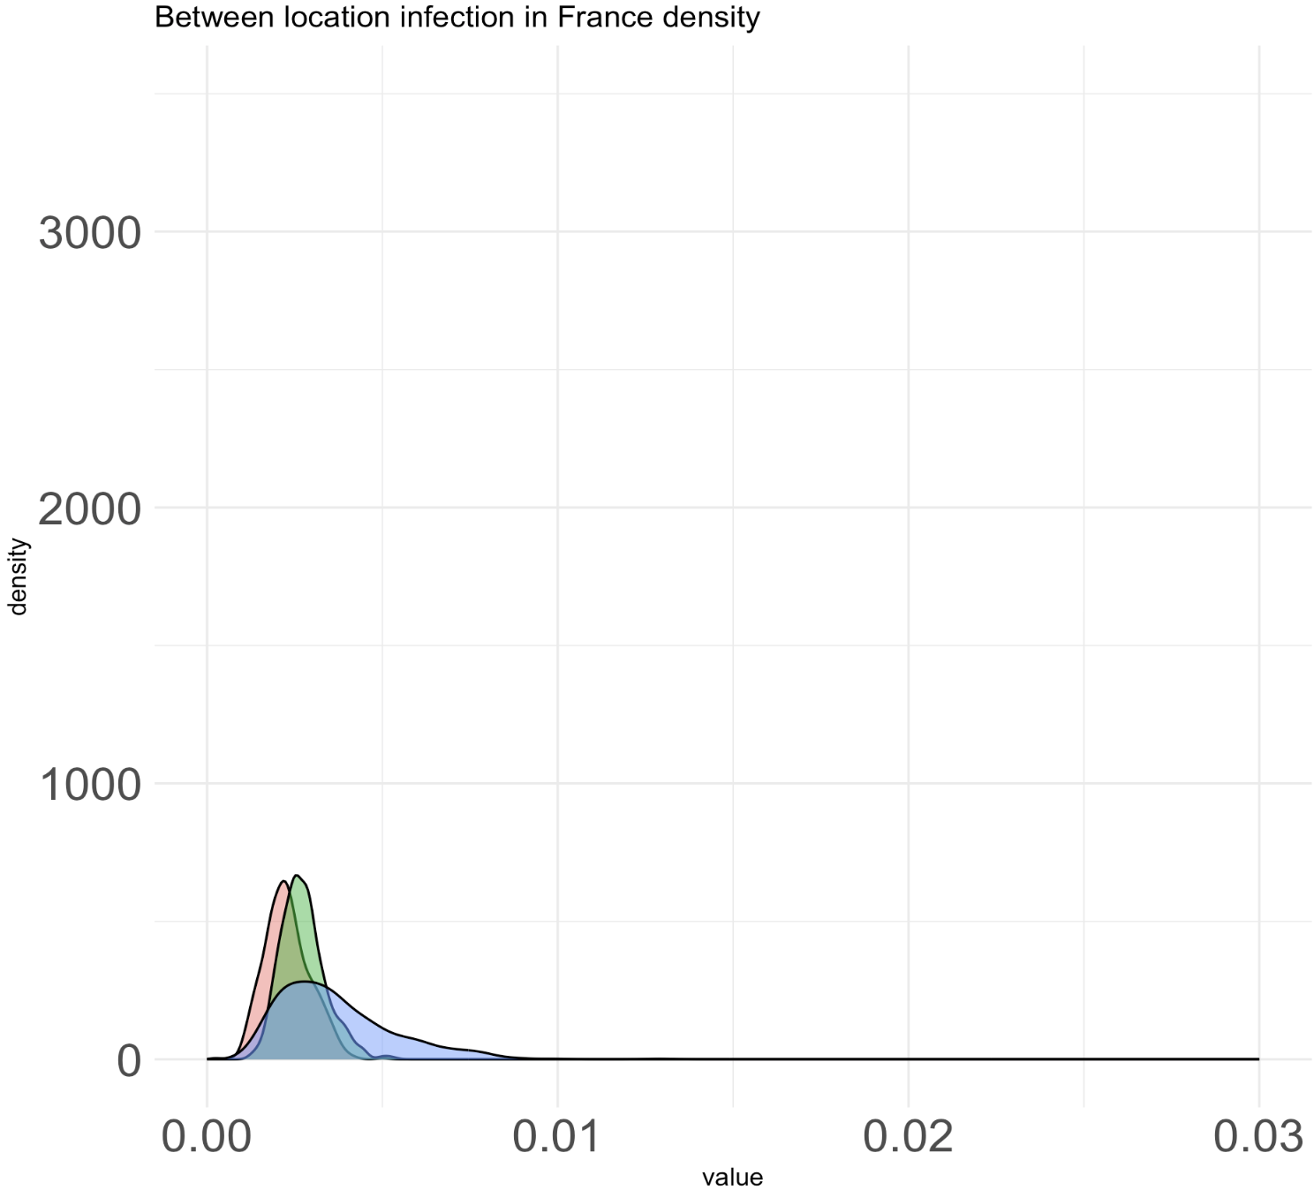
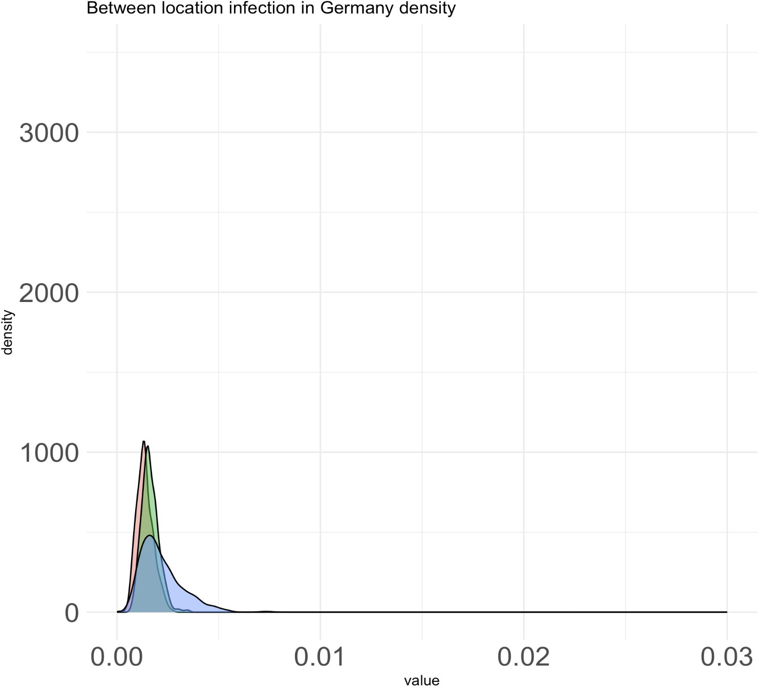
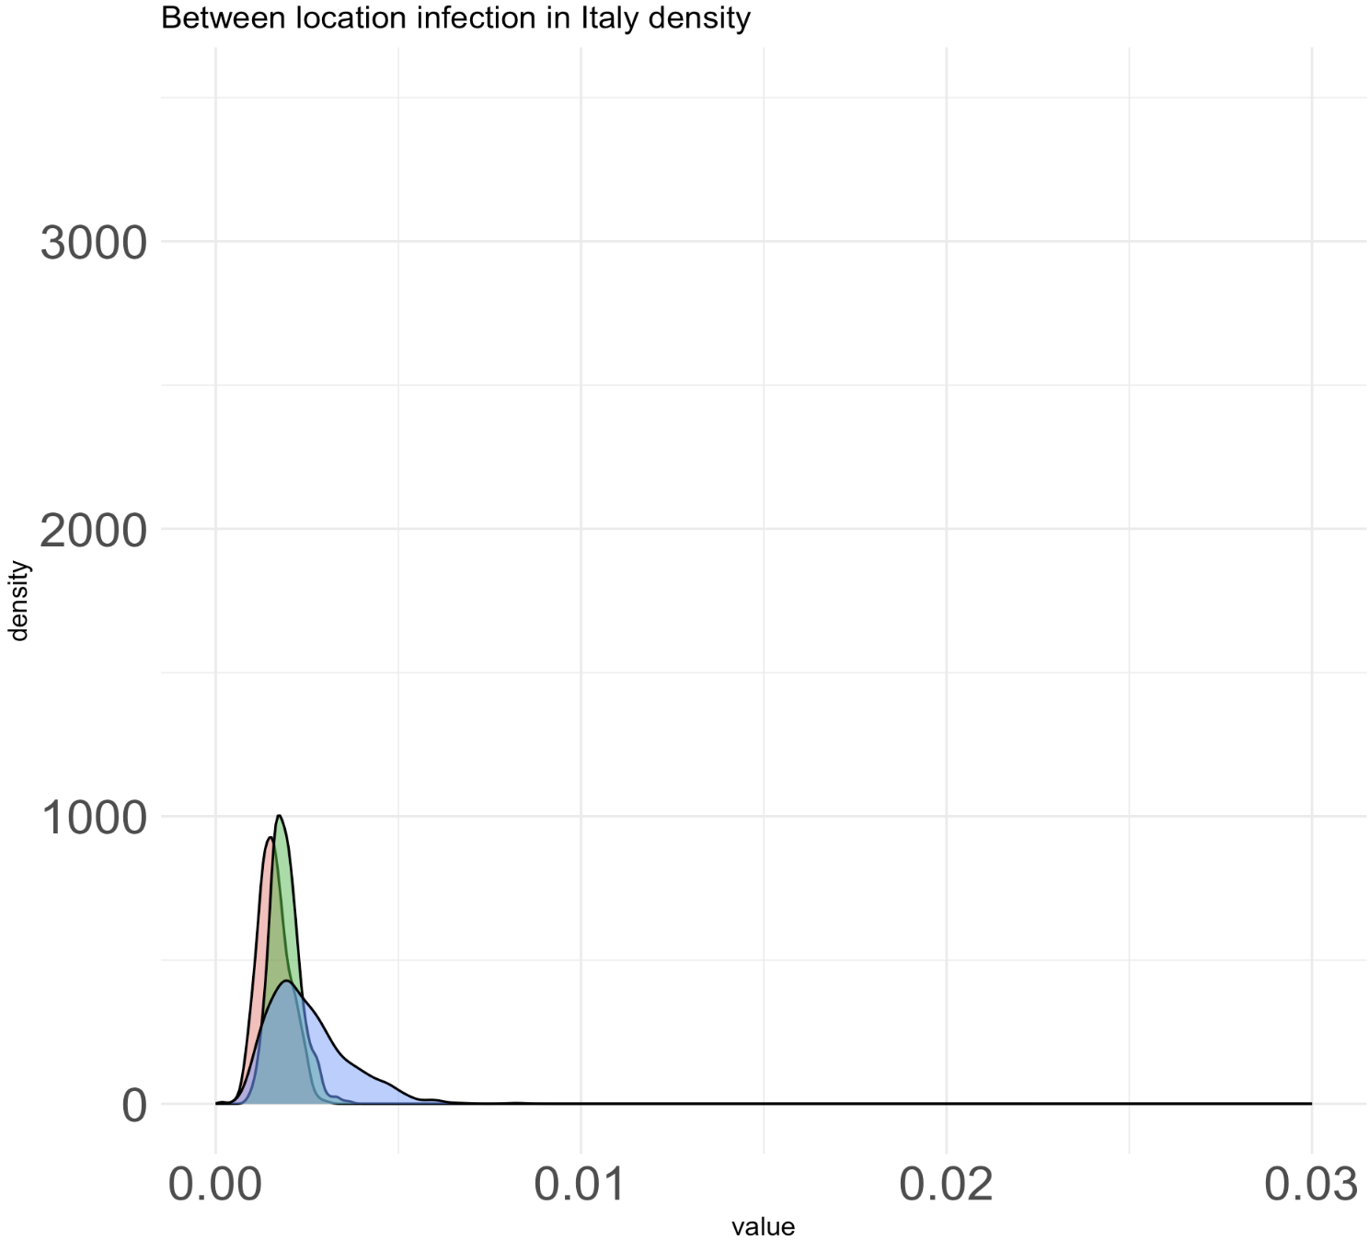
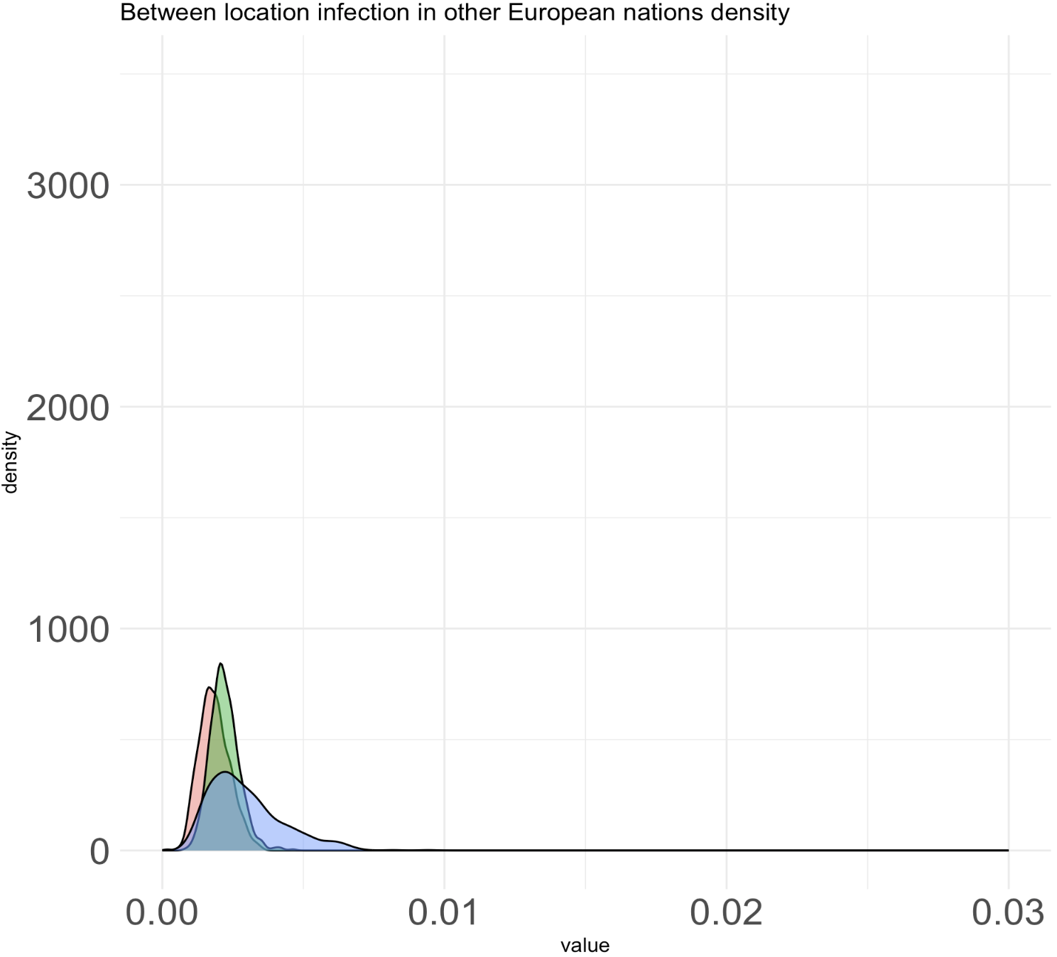
Equal rates model (new priors on sampling proportions and empirical priors)
Notes:
So why does between location rate from clado migration is now closer (still different) to the other clado migration without anagenetic migration inference?

Slide 4
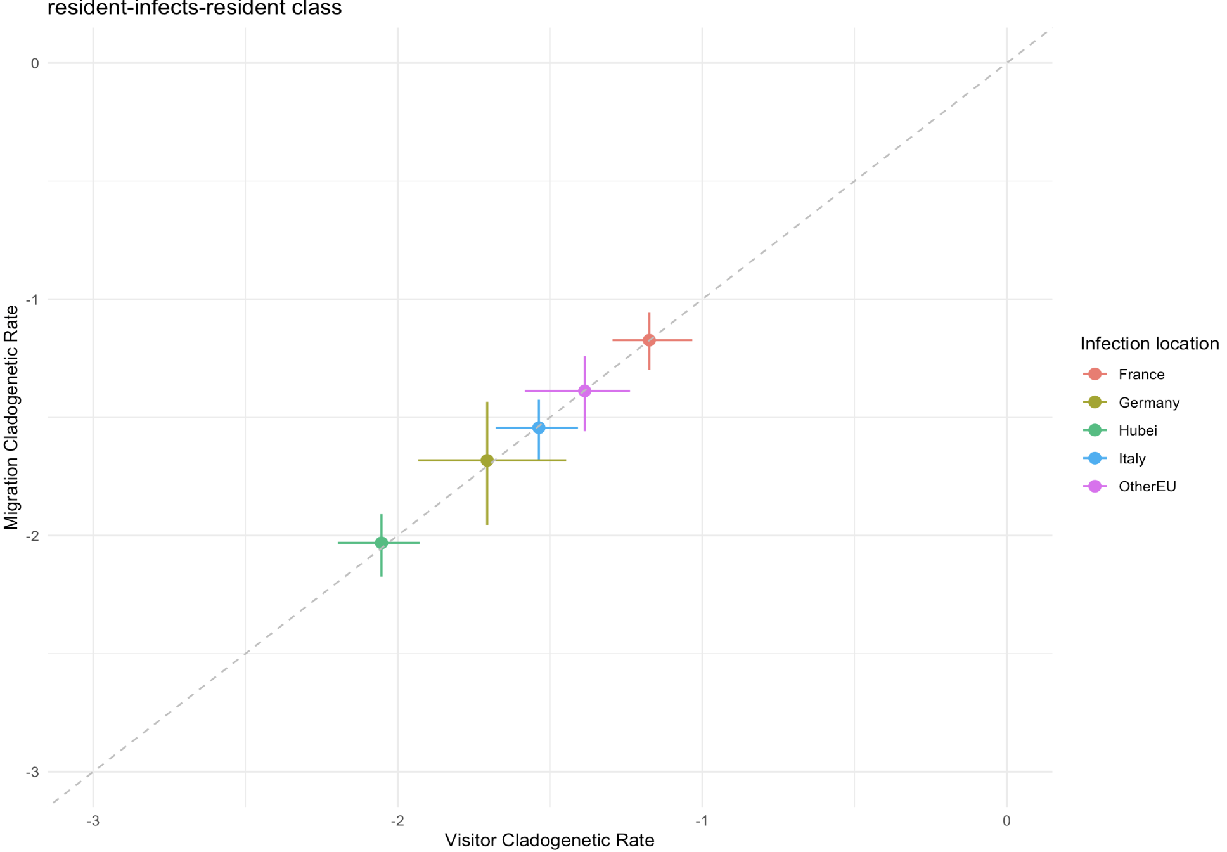
Equal rates model (new priors on sampling proportions and empirical priors)

Slide 5
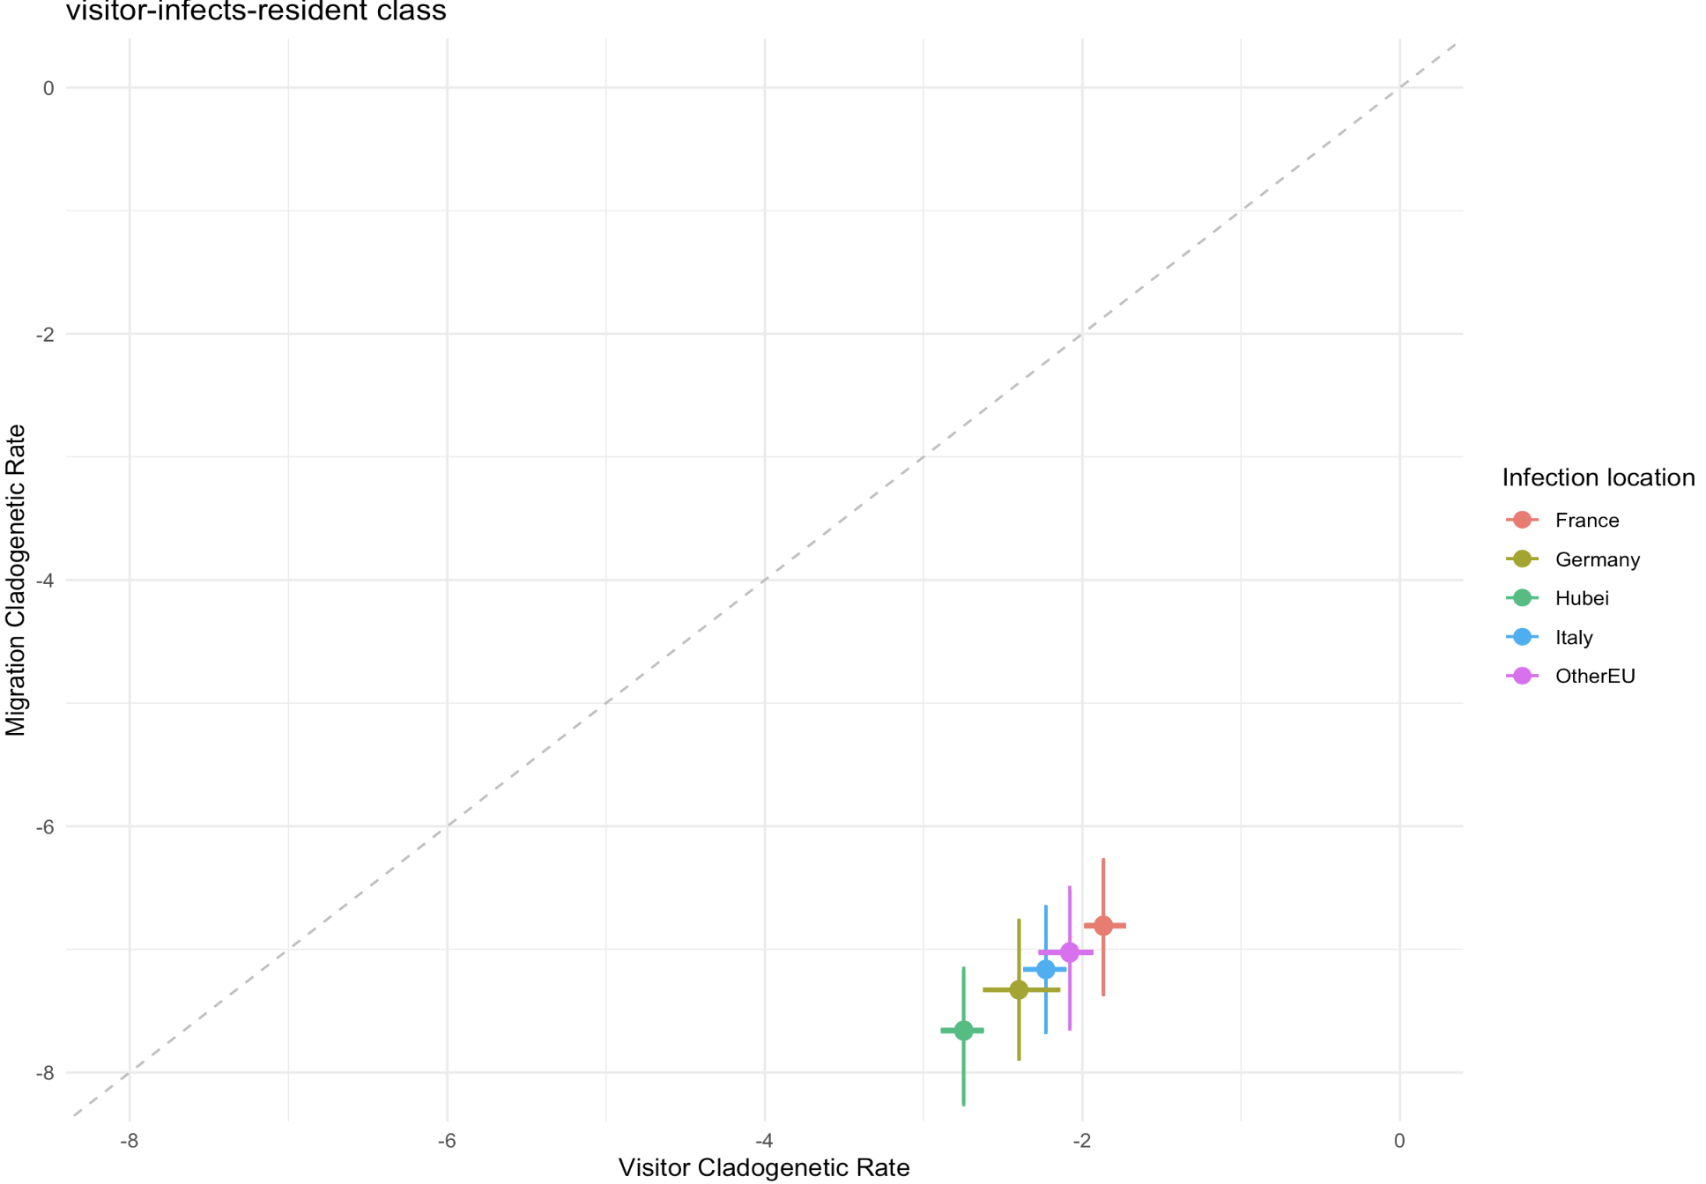
Equal rates model (new priors on sampling proportions and empirical priors)

Slide 6
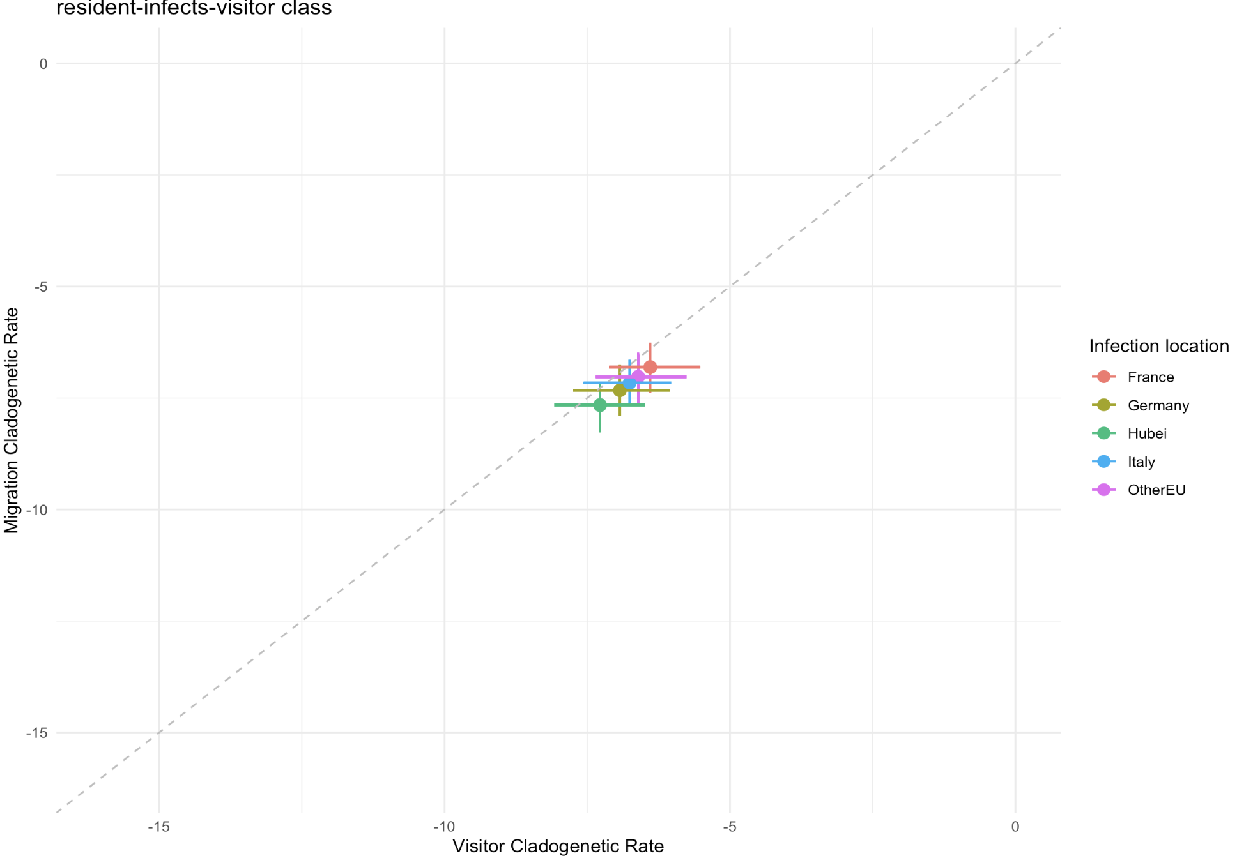
Equal rates model (new priors on sampling proportions and empirical priors)

Slide 7
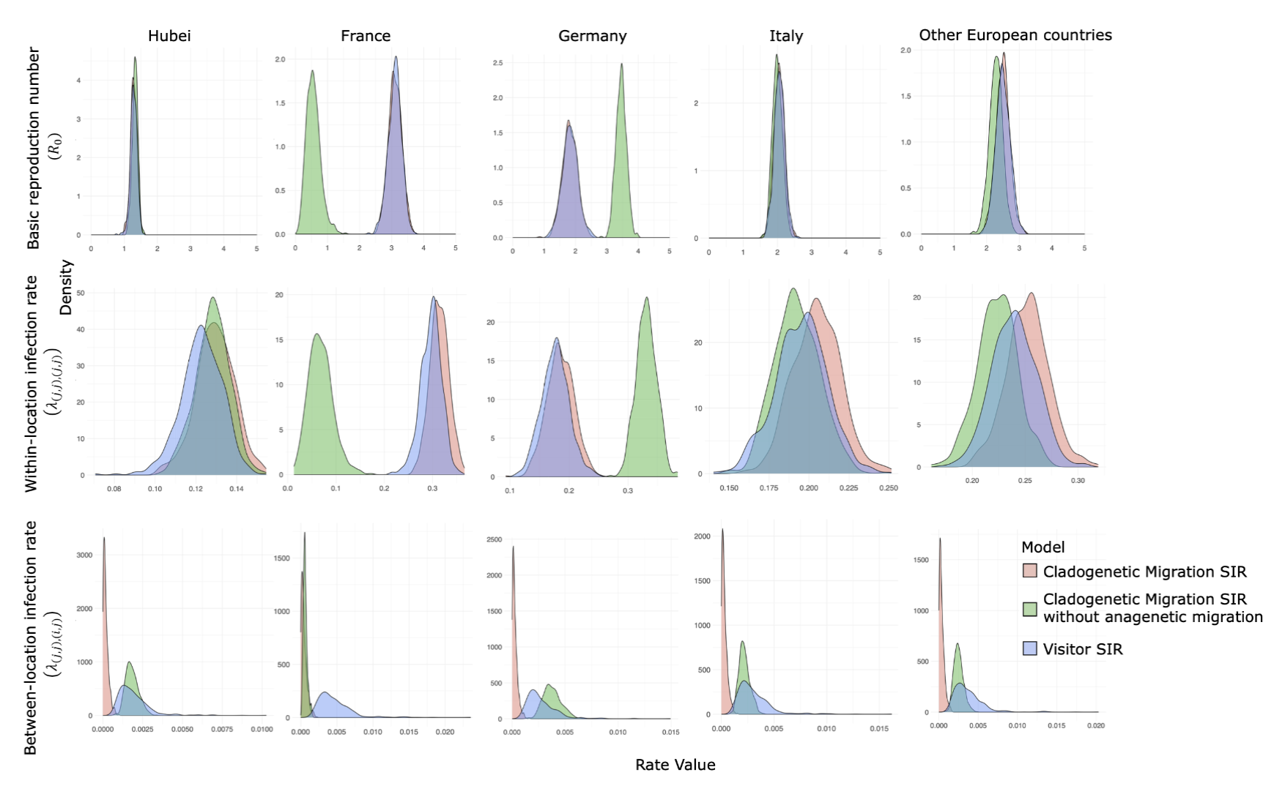
Equal rates model (priors on sampling rates and non-empirical priors)
Notes:
So why does between location rate from clado migration without anagenetic migration is now closer to the other clado migration inference?

Slide 8
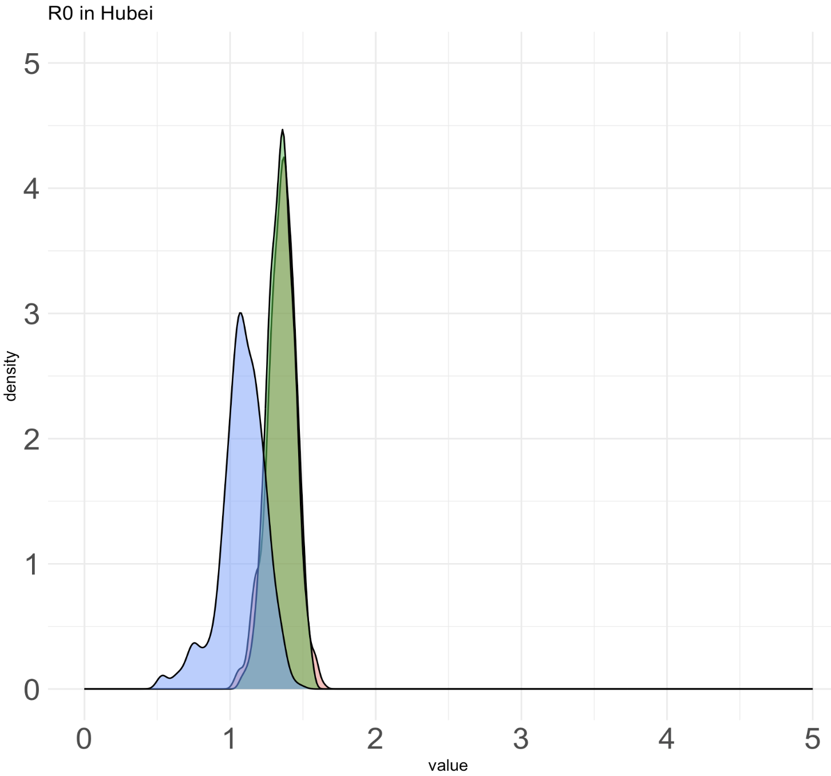
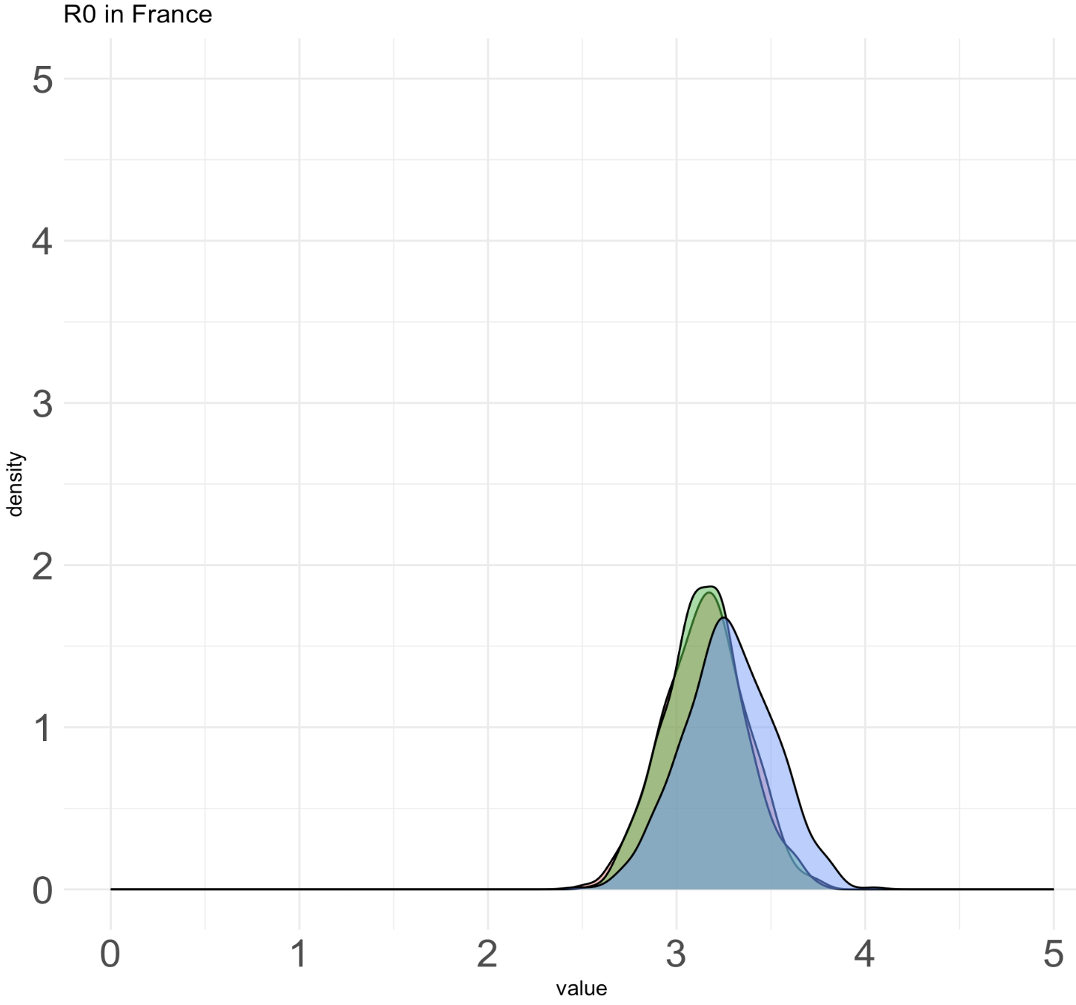
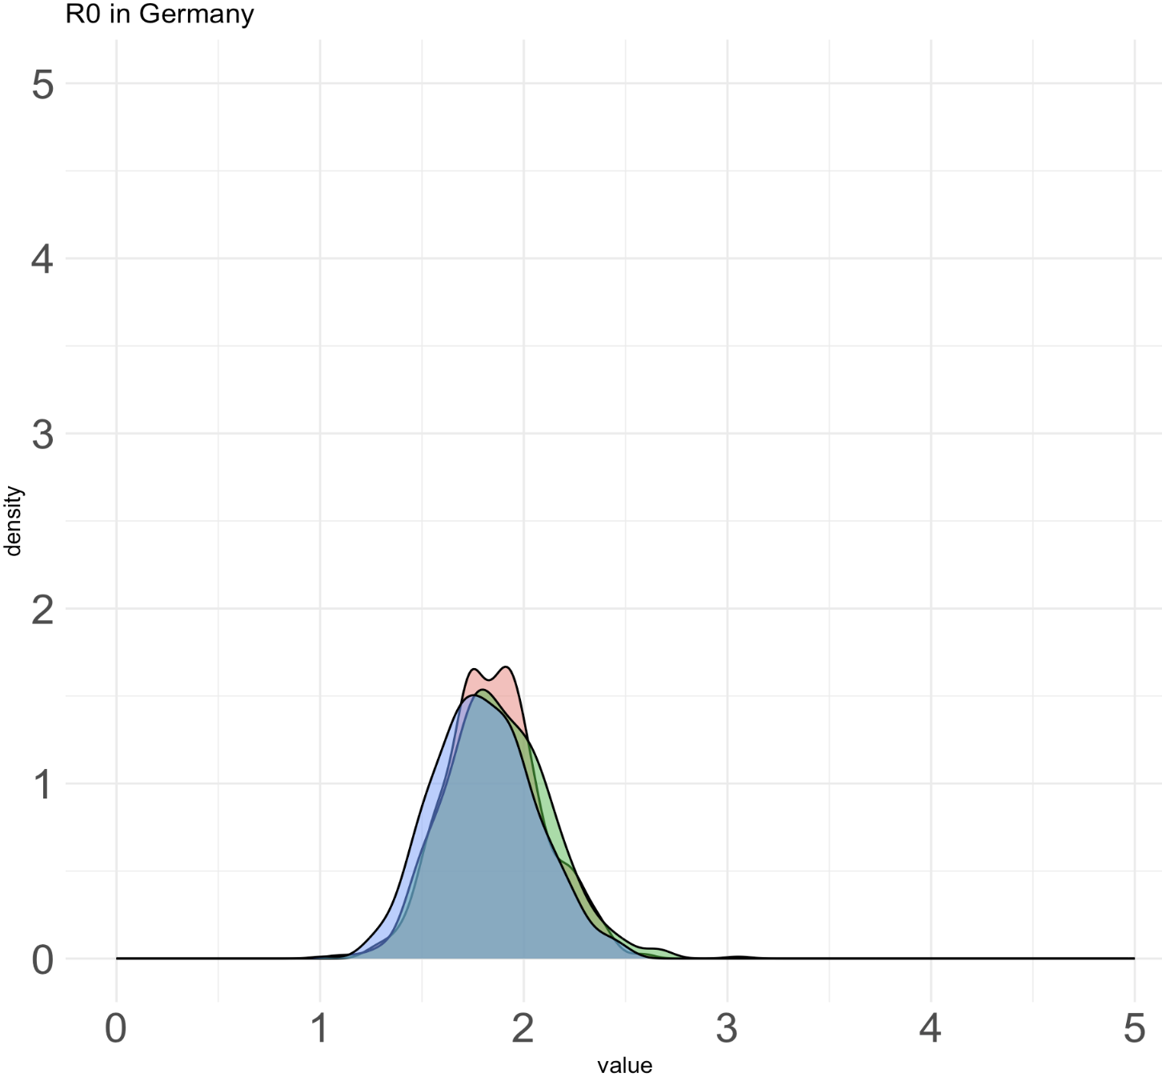
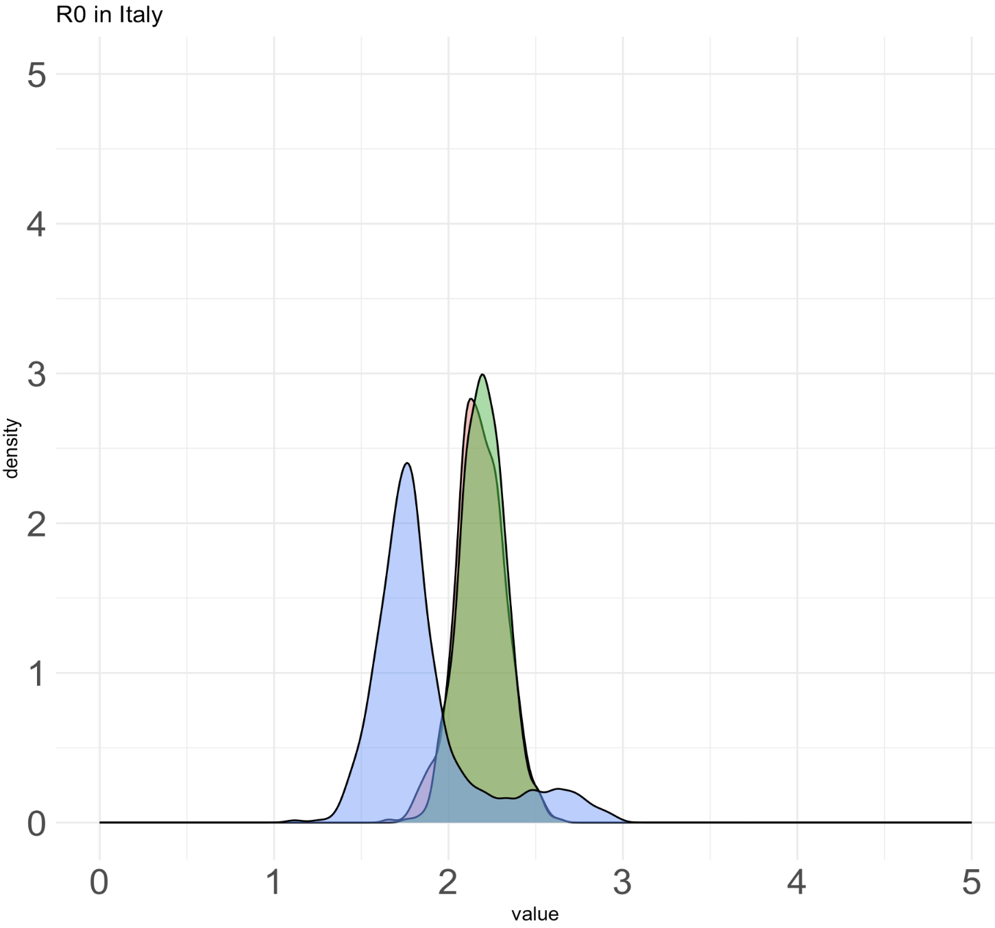
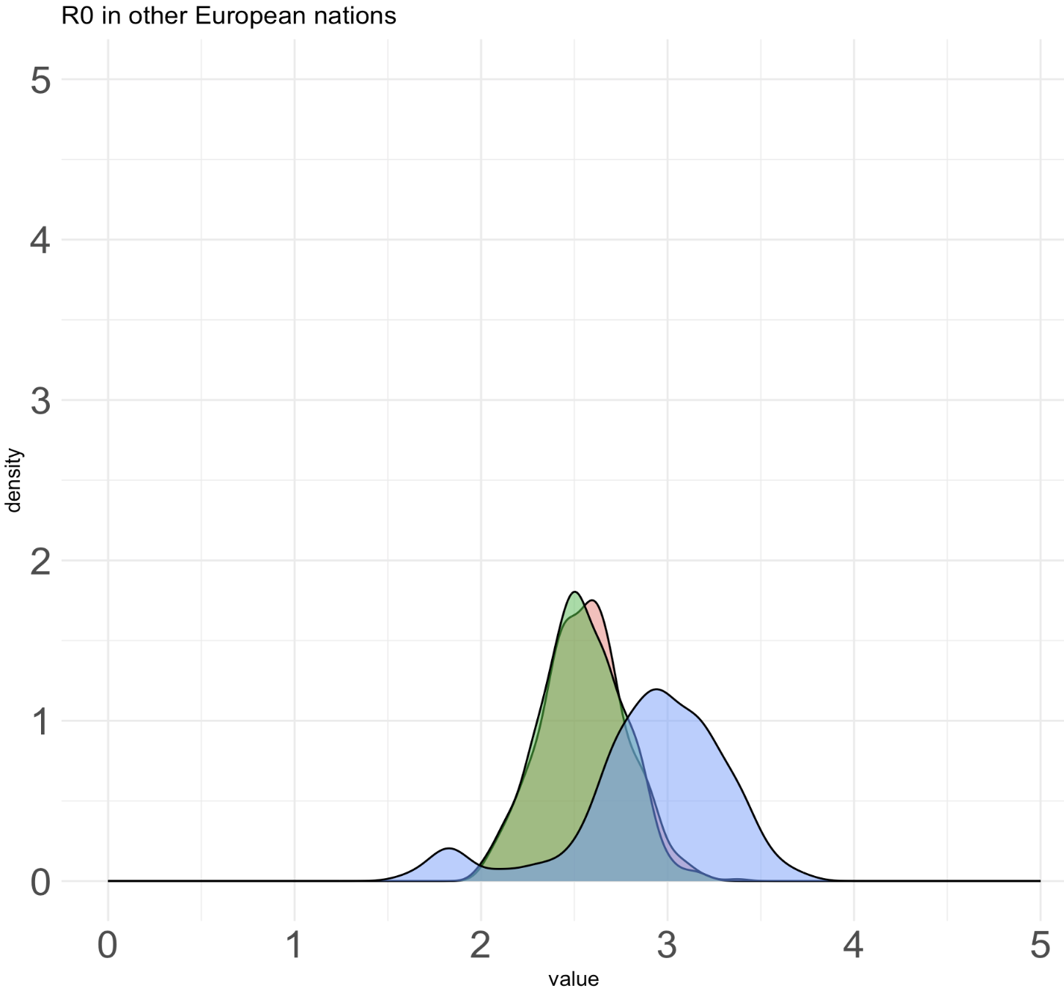
Unequal rates model (new priors on sampling proportions and empirical priors) – visitor has bad mixing problem

Slide 9
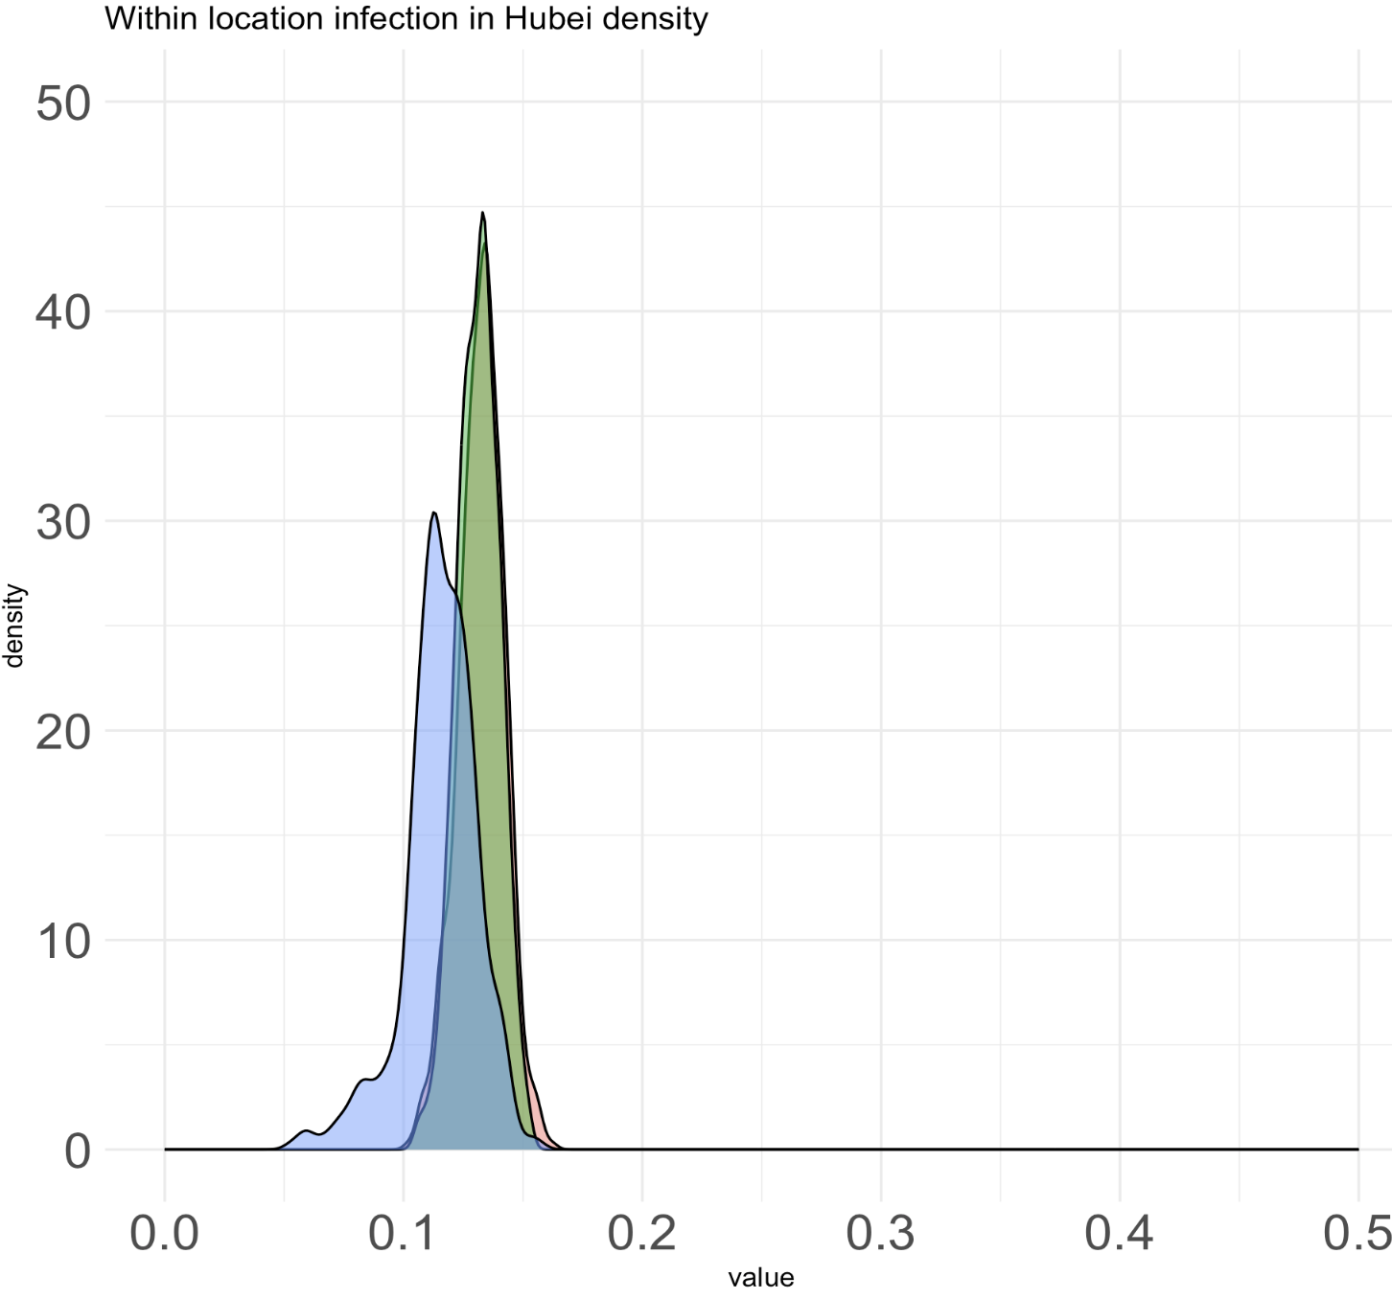
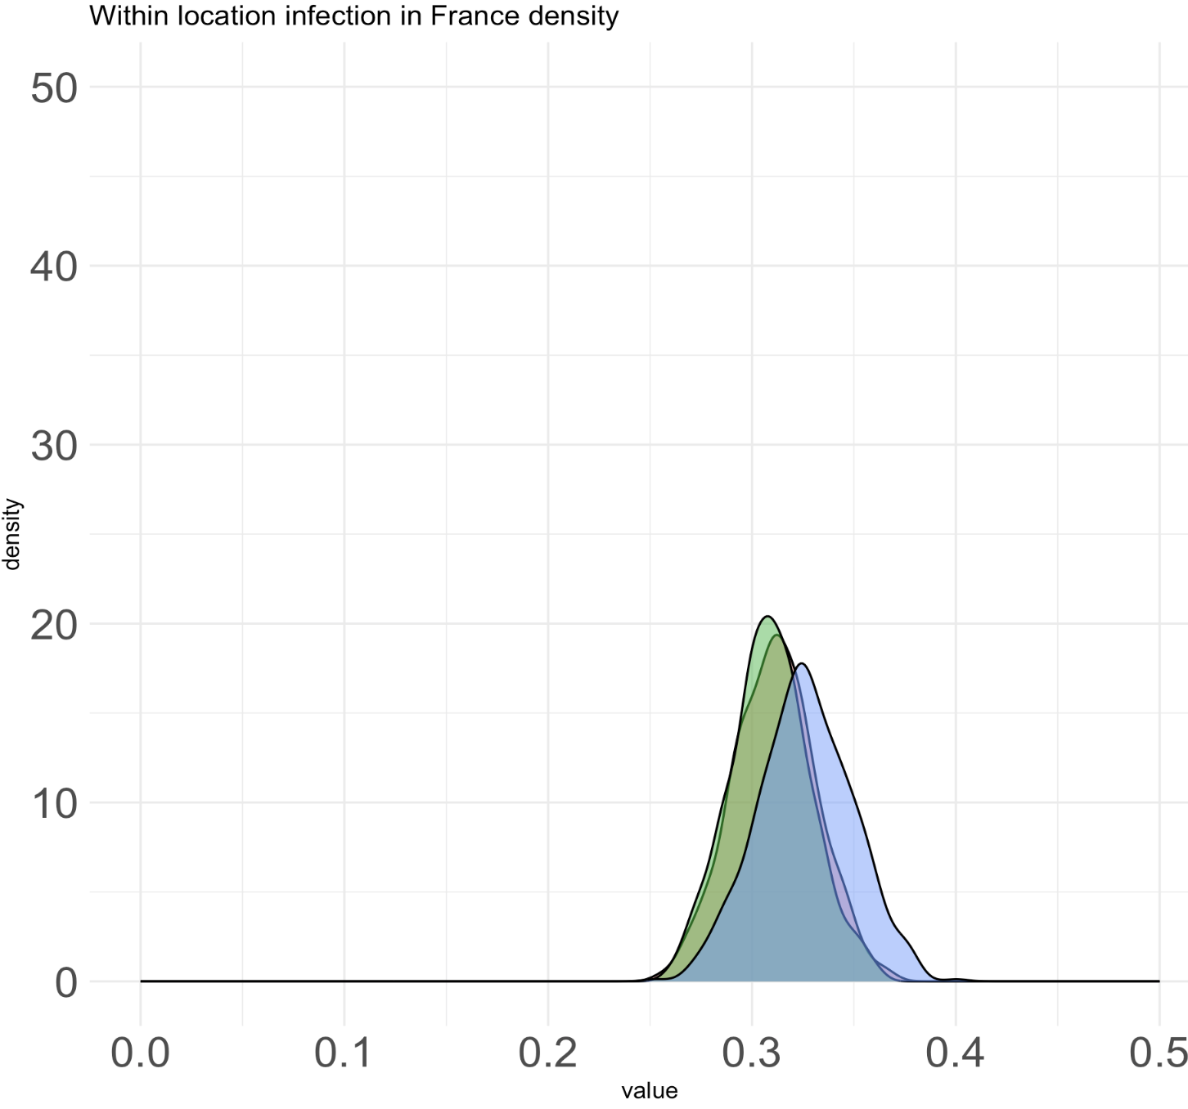
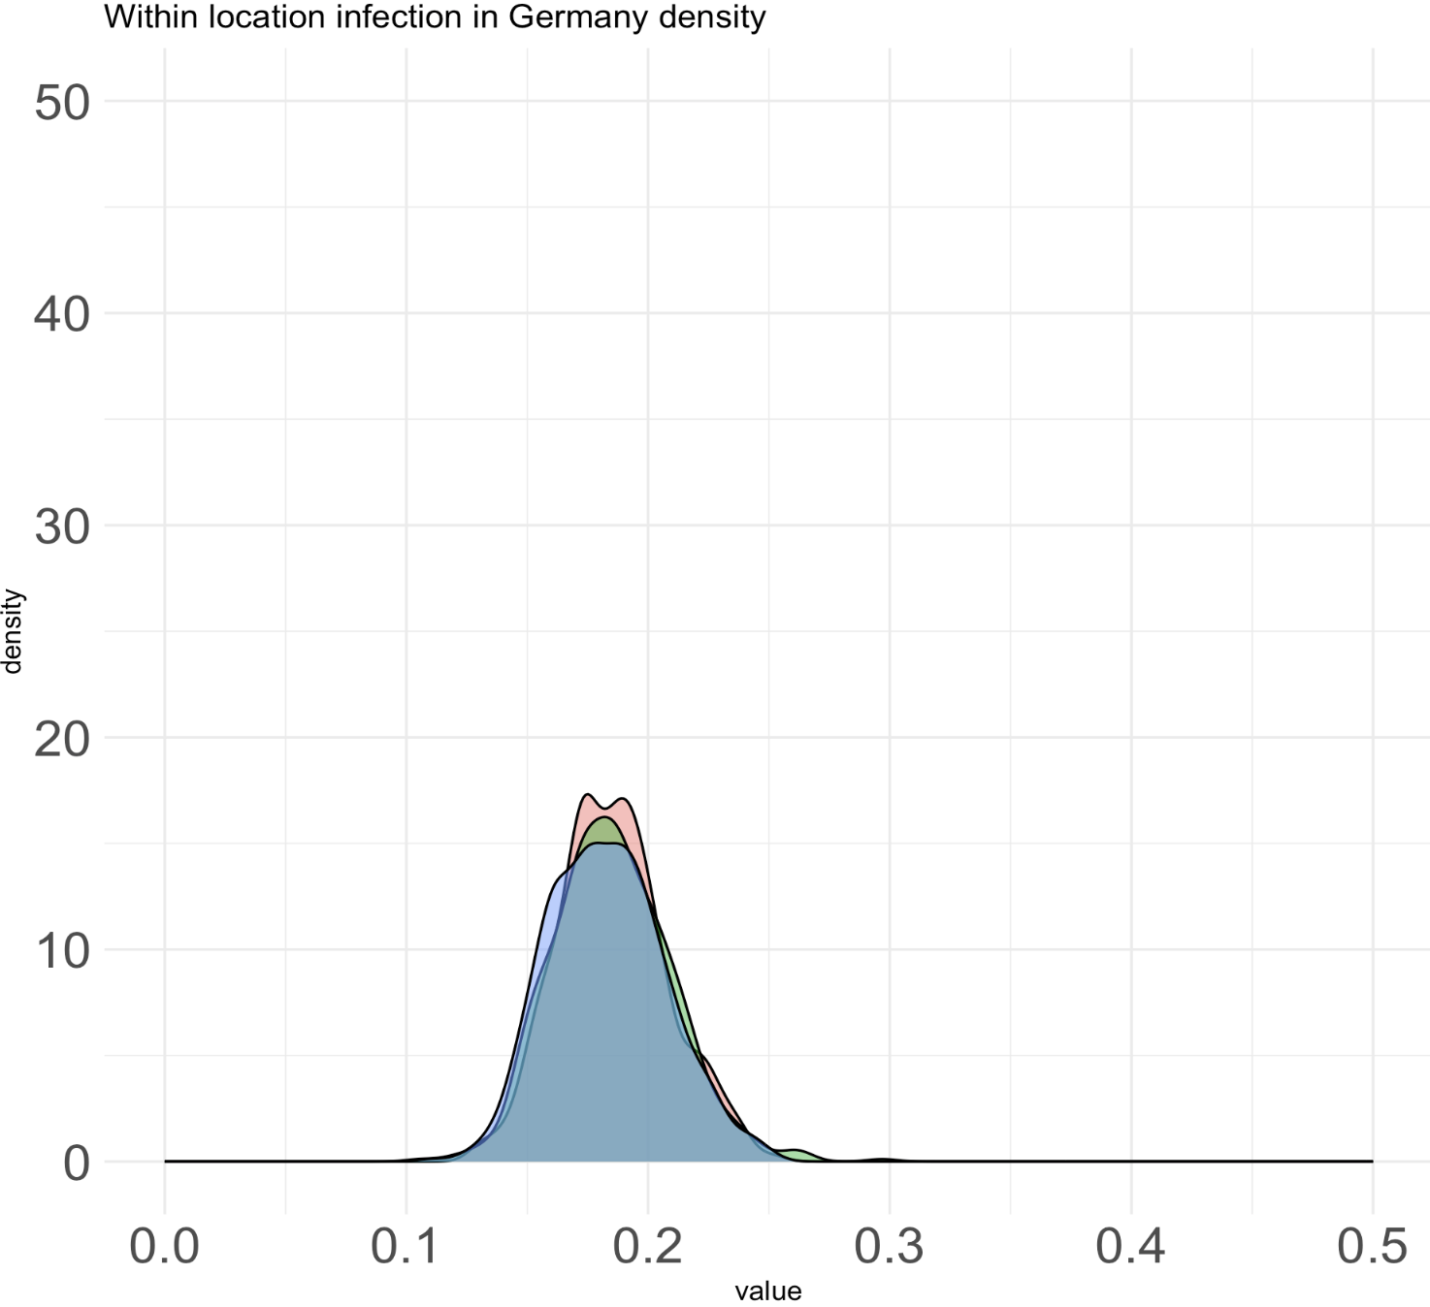
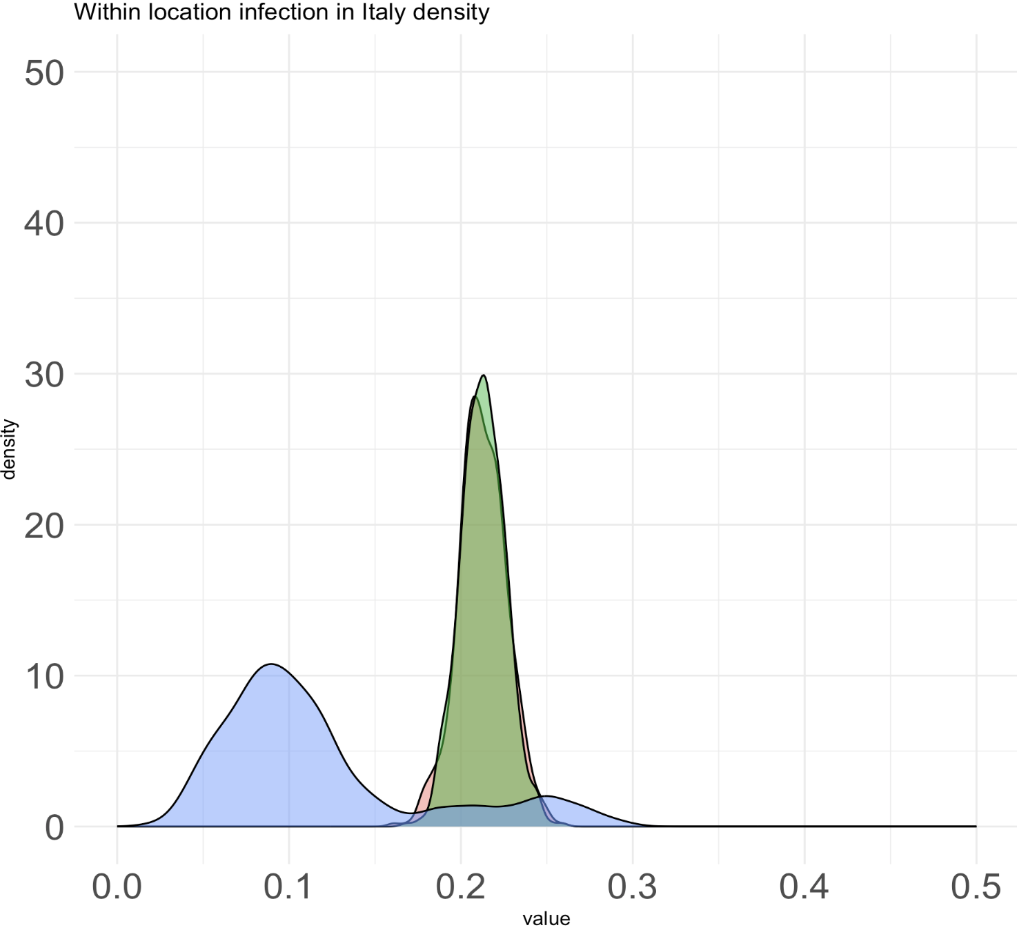
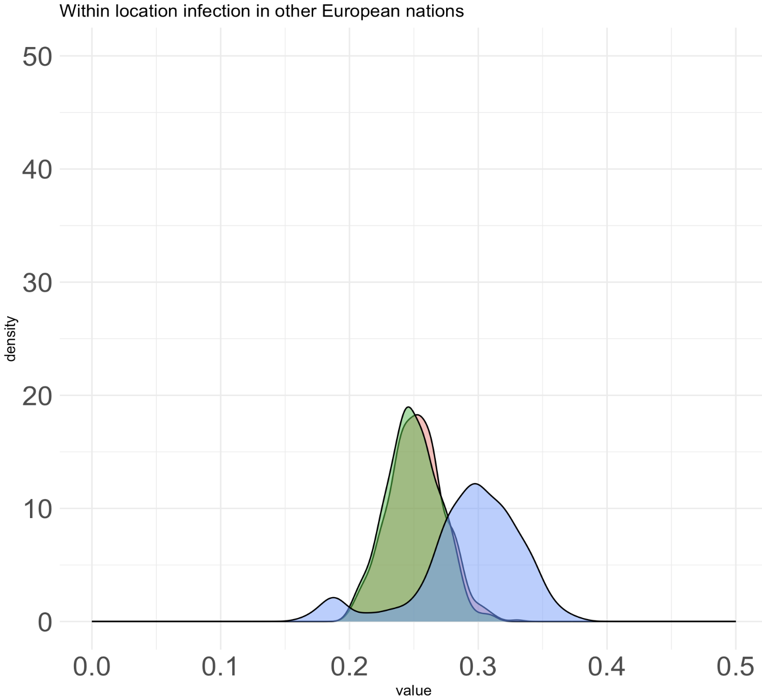
Unequal rates model (new priors on sampling proportions and empirical priors) – visitor has bad mixing problem
Notes:
Seems like mixing problem, when the chain reaches convergence for visitor model like in Germany, their means are similar.

Slide 10
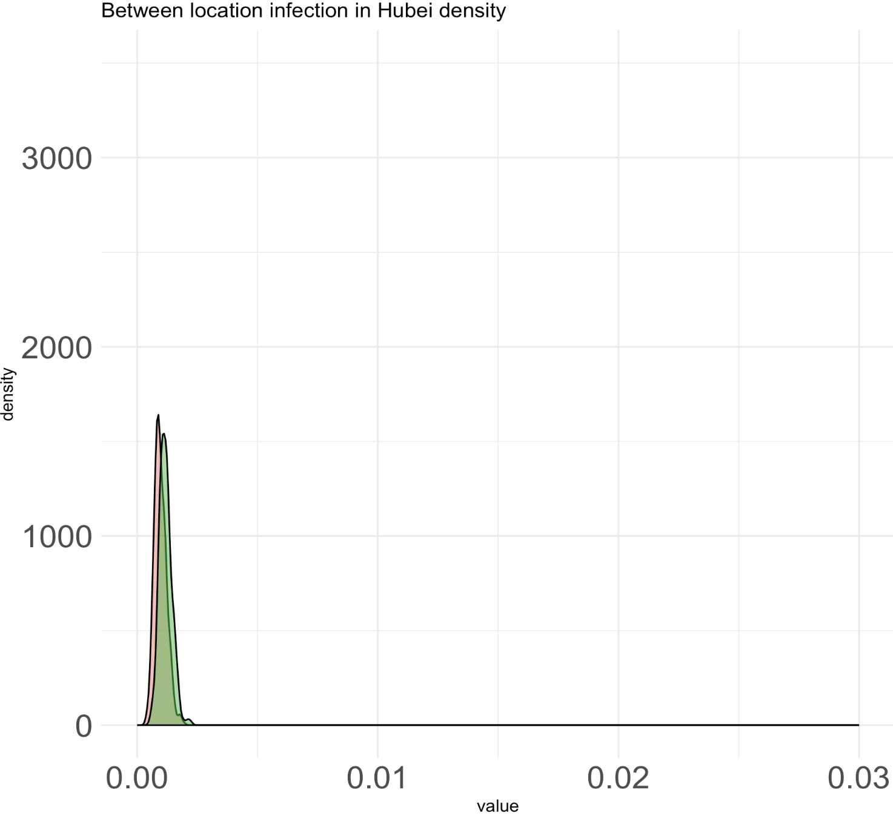
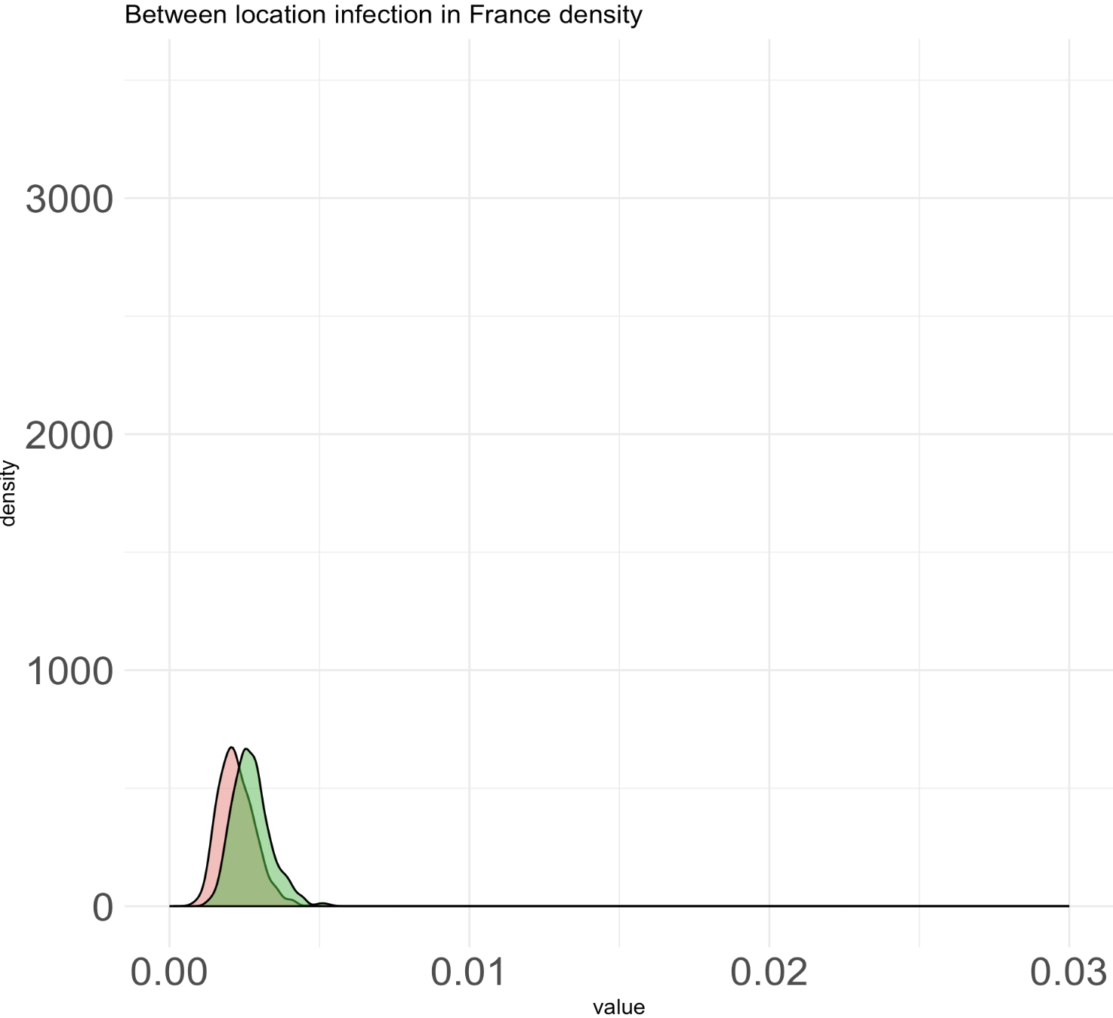
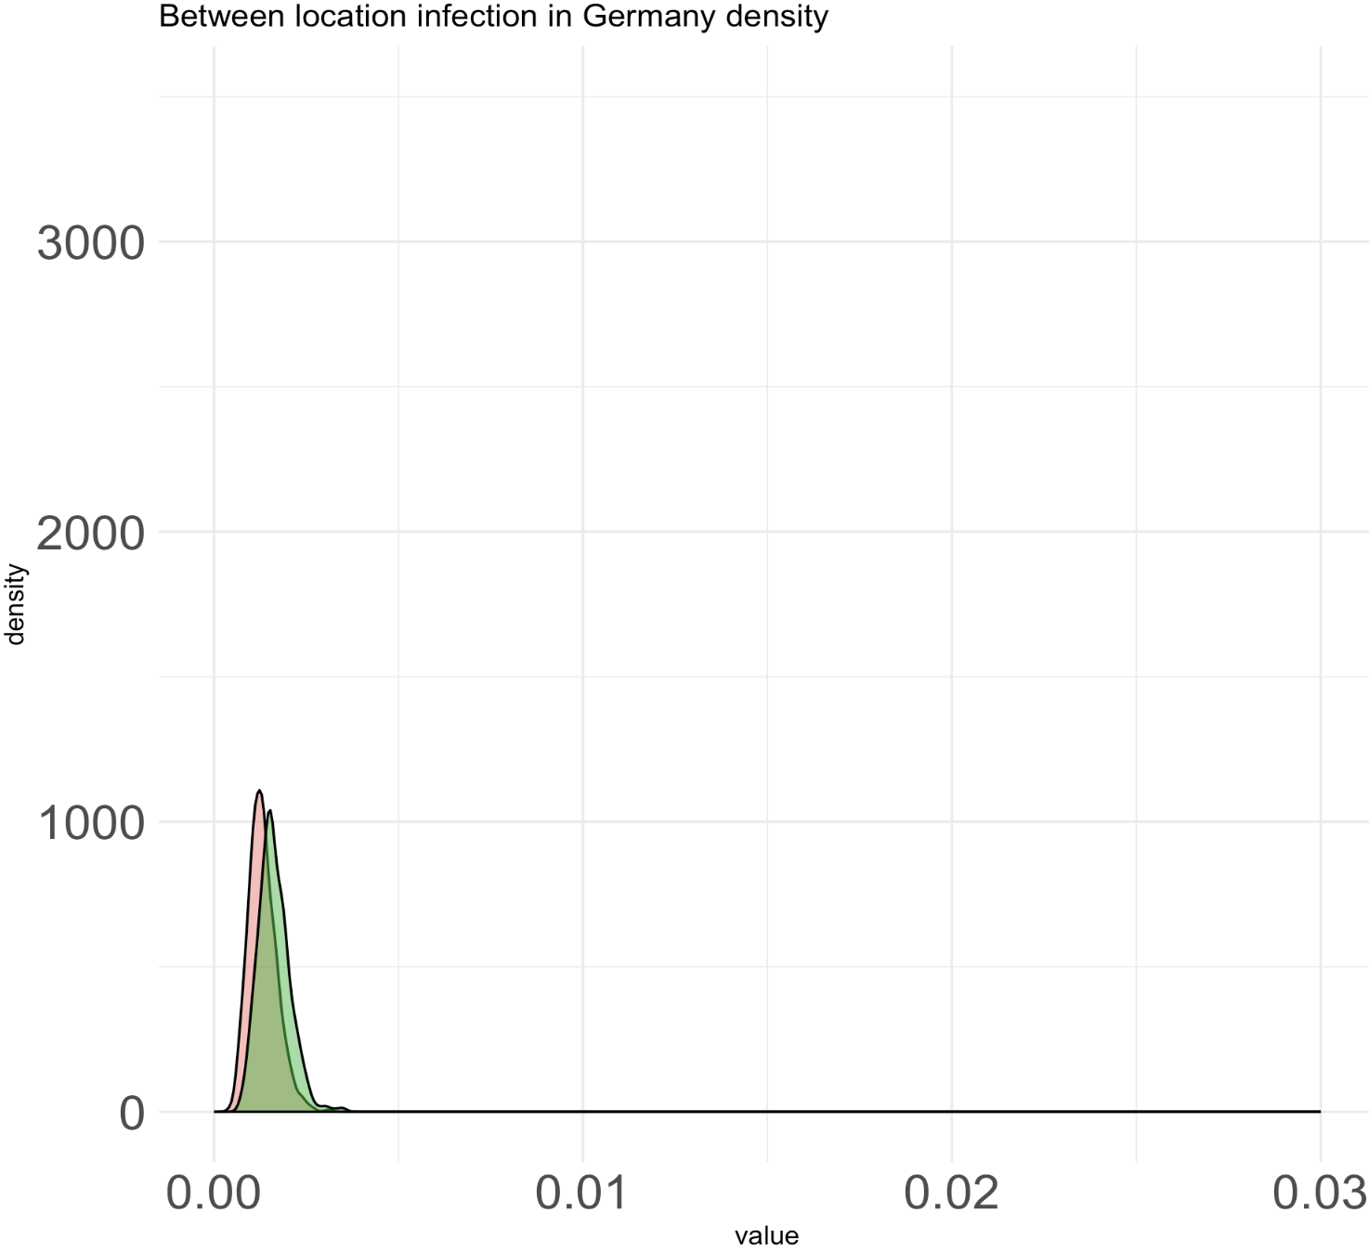
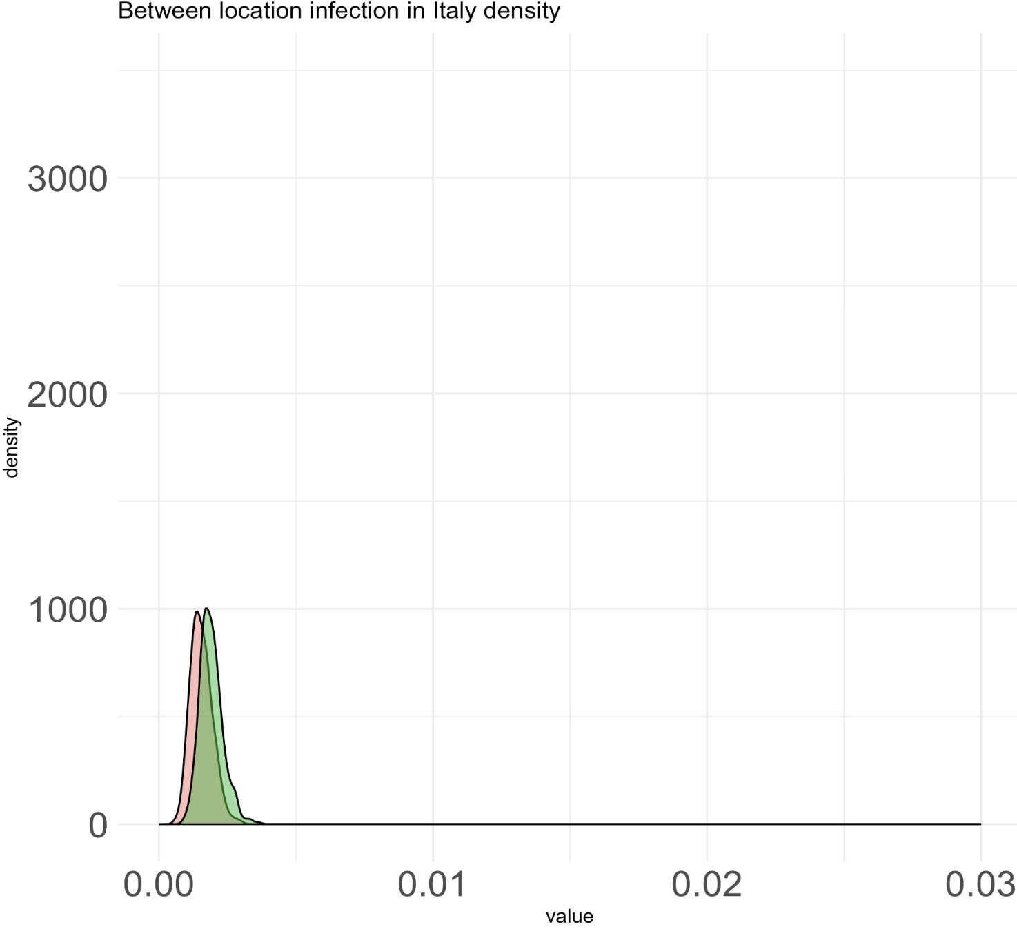
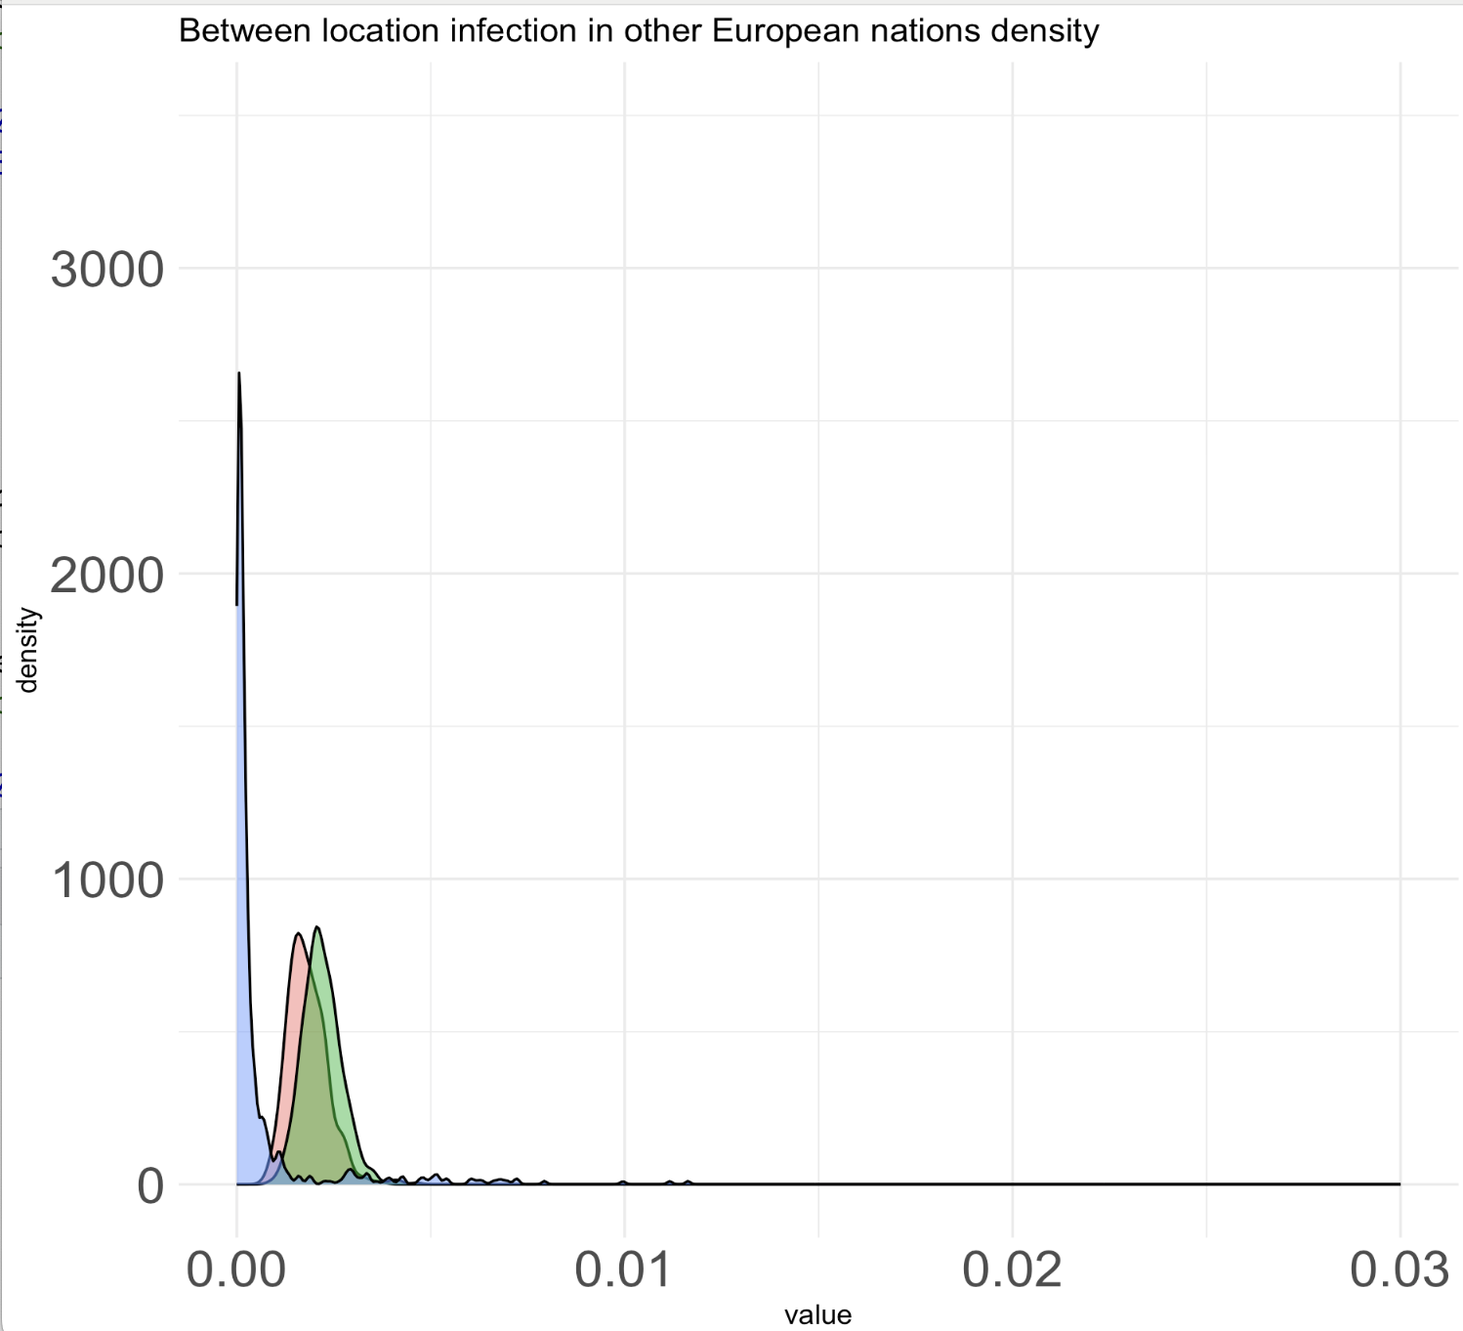
Unequal rates model (new priors on sampling proportions and empirical priors) – visitor has bad mixing problem
Notes:
Seems like mixing problem, when the chain reaches convergence for visitor model like in Germany, their means are similar (for R0 and within region speciation).
Between-region in France, the chain reaches convergence, but its posterior mean is different than the one using old priors (the new one is 10^-2 slower).

Slide 11
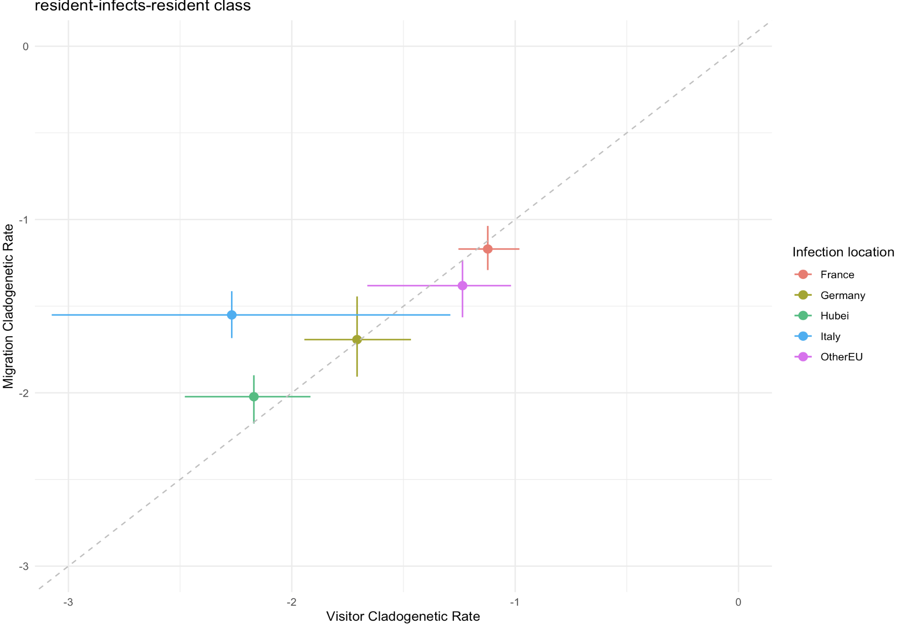
Unequal rates model (new priors on sampling proportions and empirical priors) – visitor has bad mixing problem

Slide 12
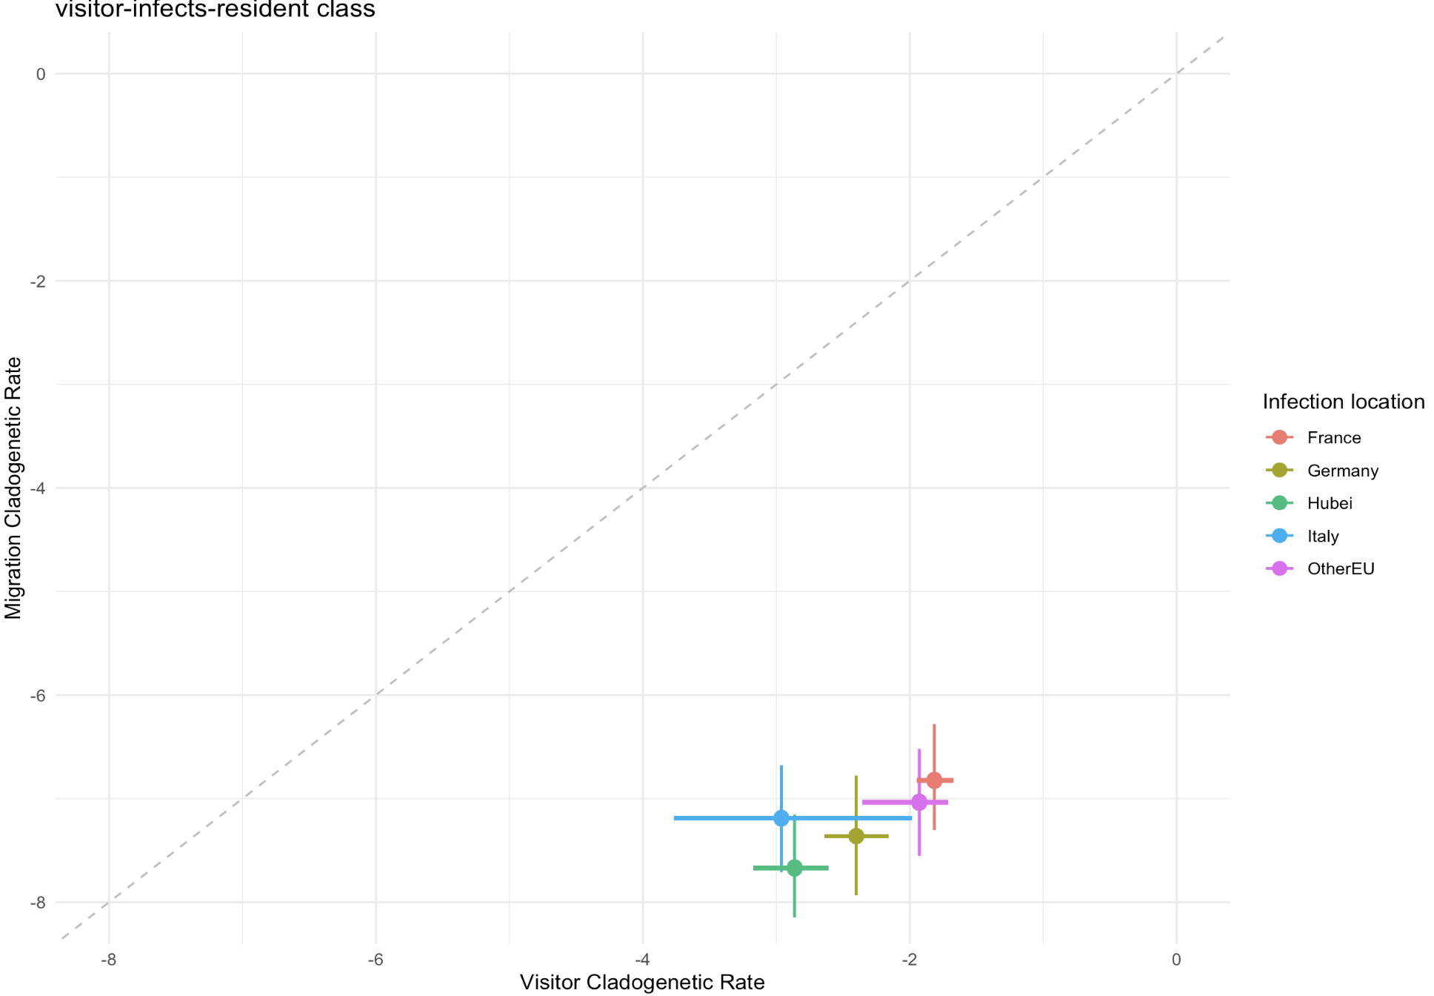
Unequal rates model (new priors on sampling proportions and empirical priors) – visitor has bad mixing problem

Slide 13
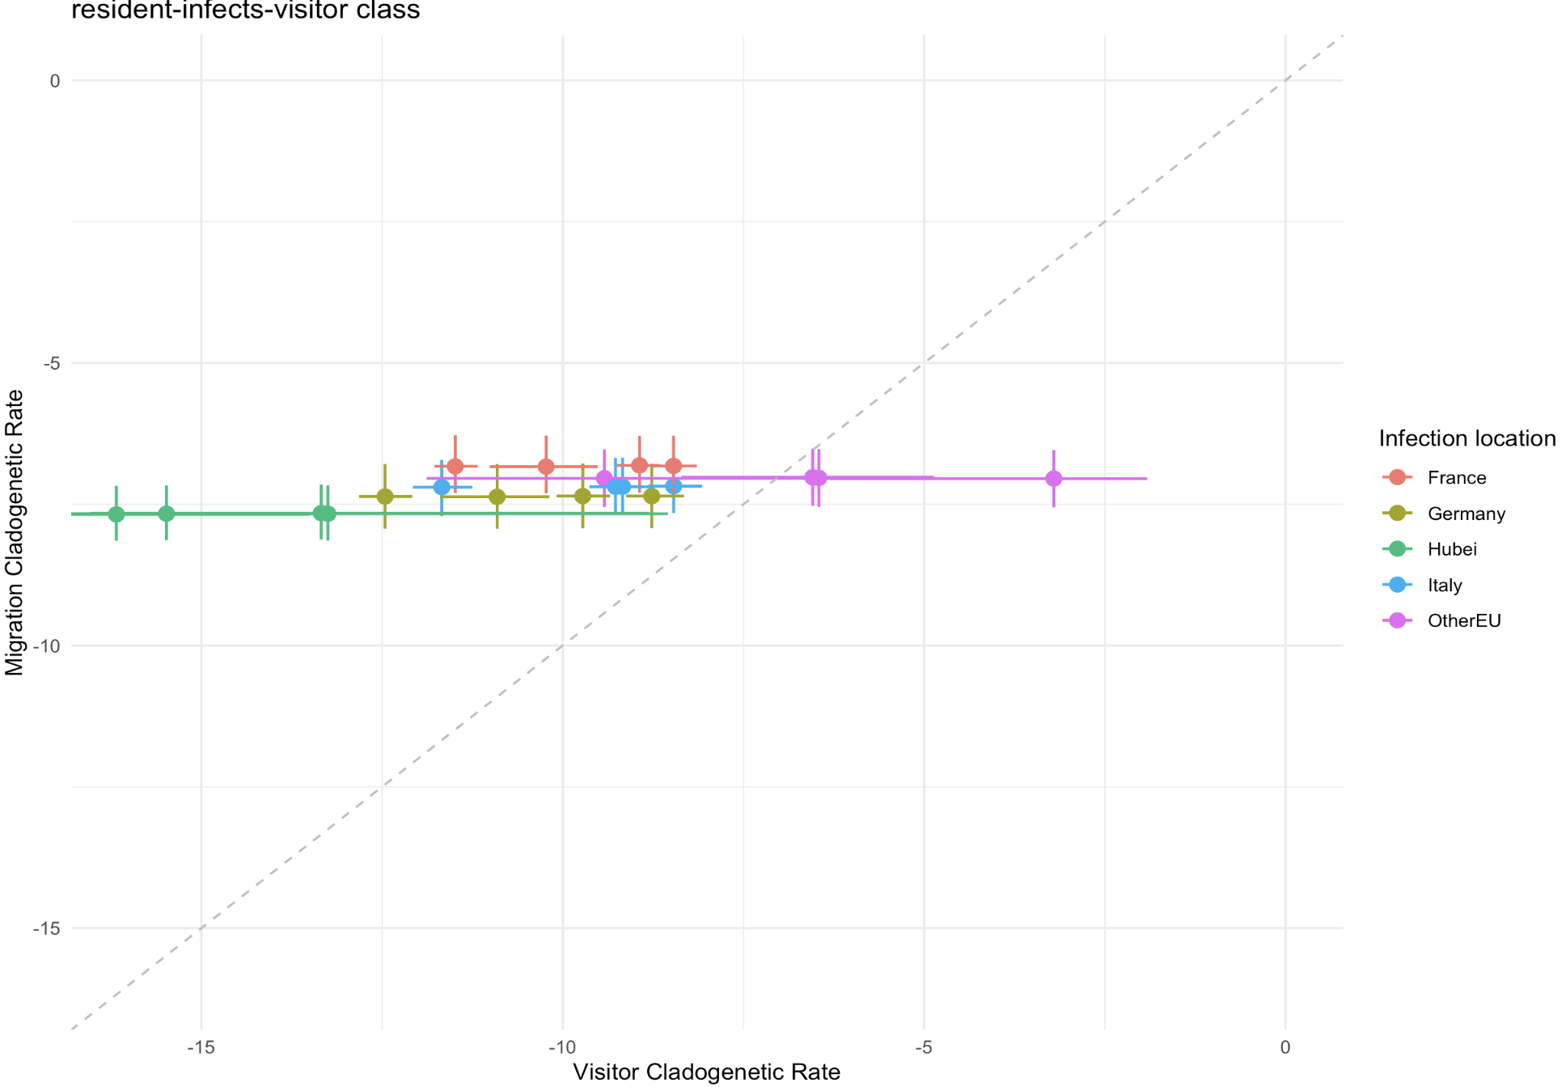
Unequal rates model (new priors on sampling proportions and empirical priors) – visitor has bad mixing problem
Notes:
Two visitor events have rates >> 0.005

Slide 14
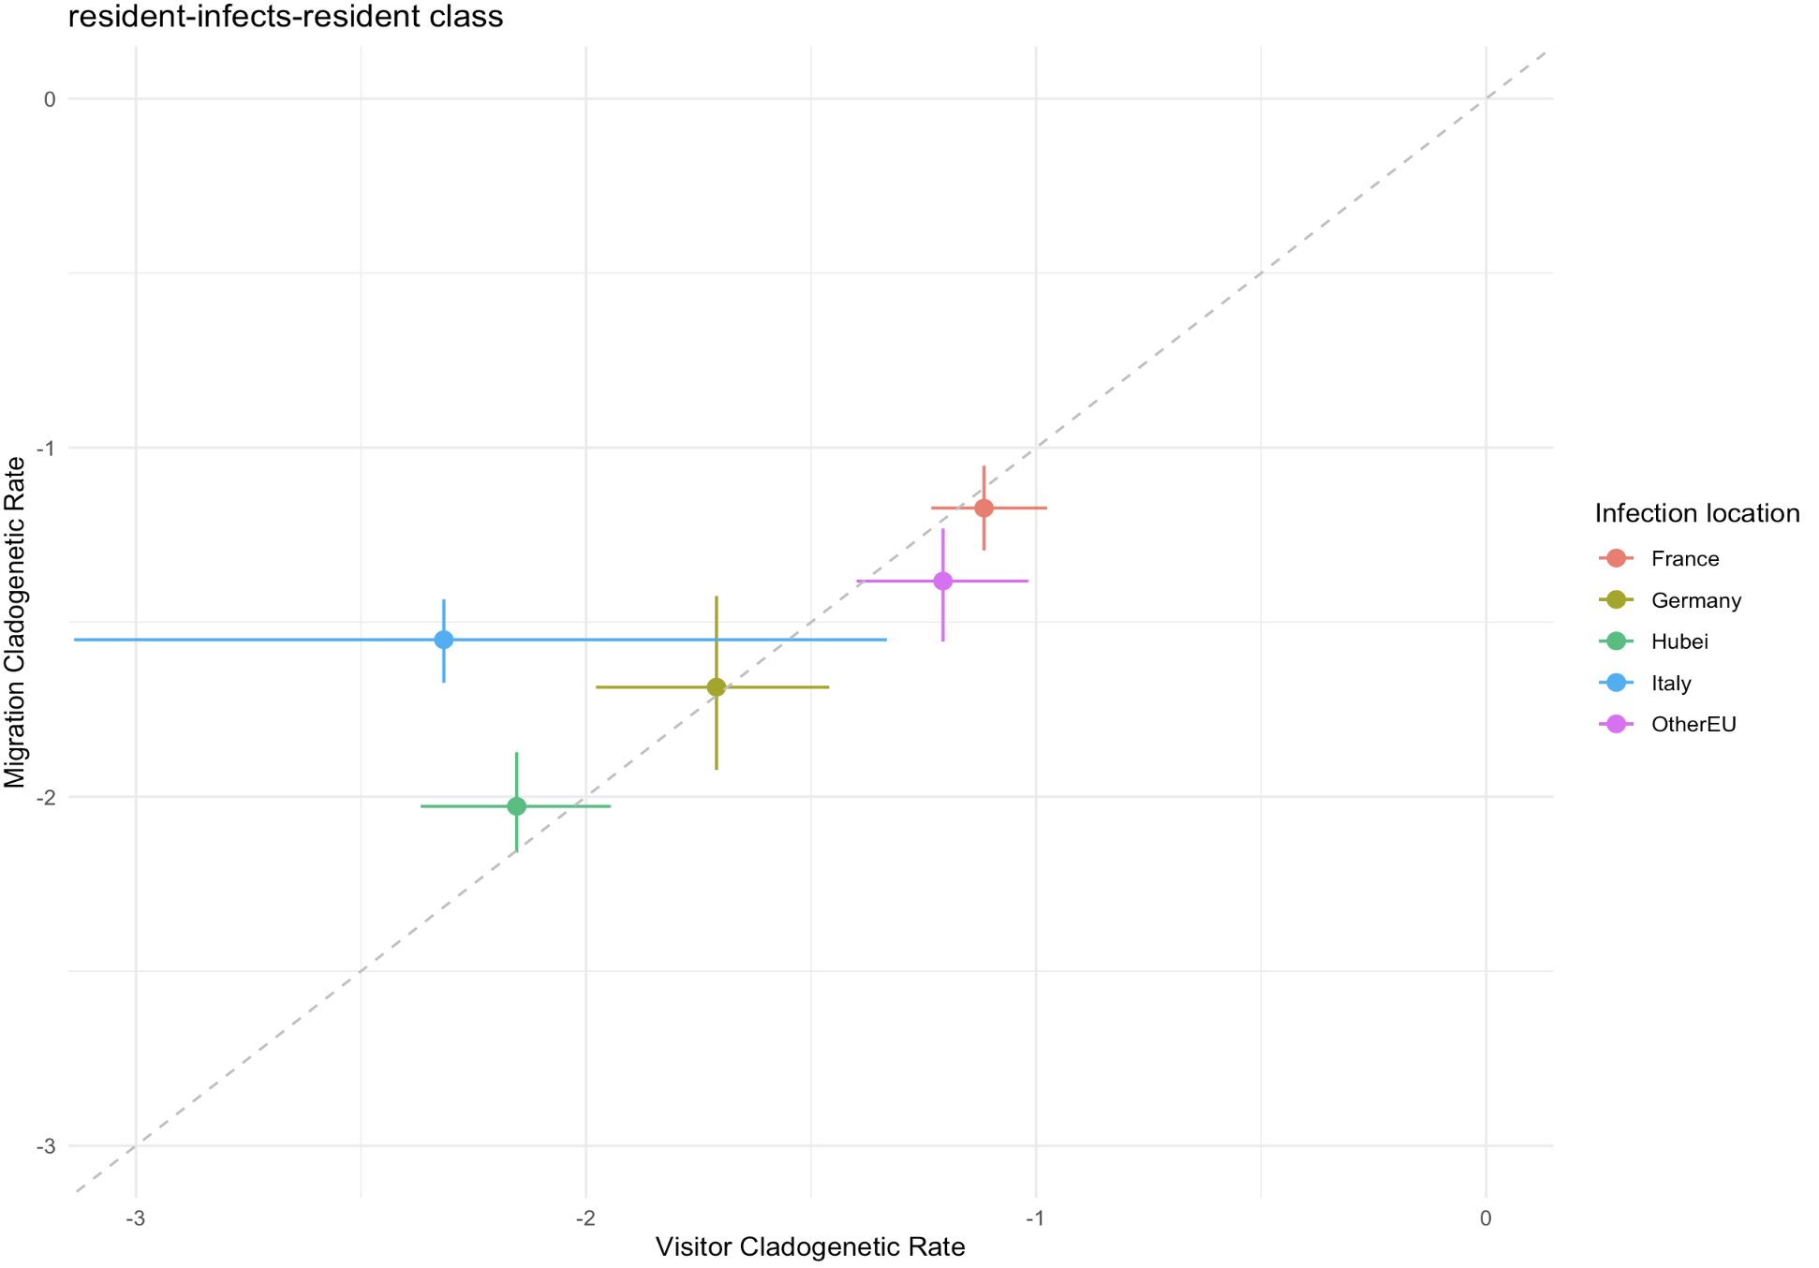
Unequal rates model (new priors on sampling proportions and empirical priors) – with burn-in on visitor – fewer mixing problem
Notes:
Two visitor events have rates >> 0.005

Slide 15
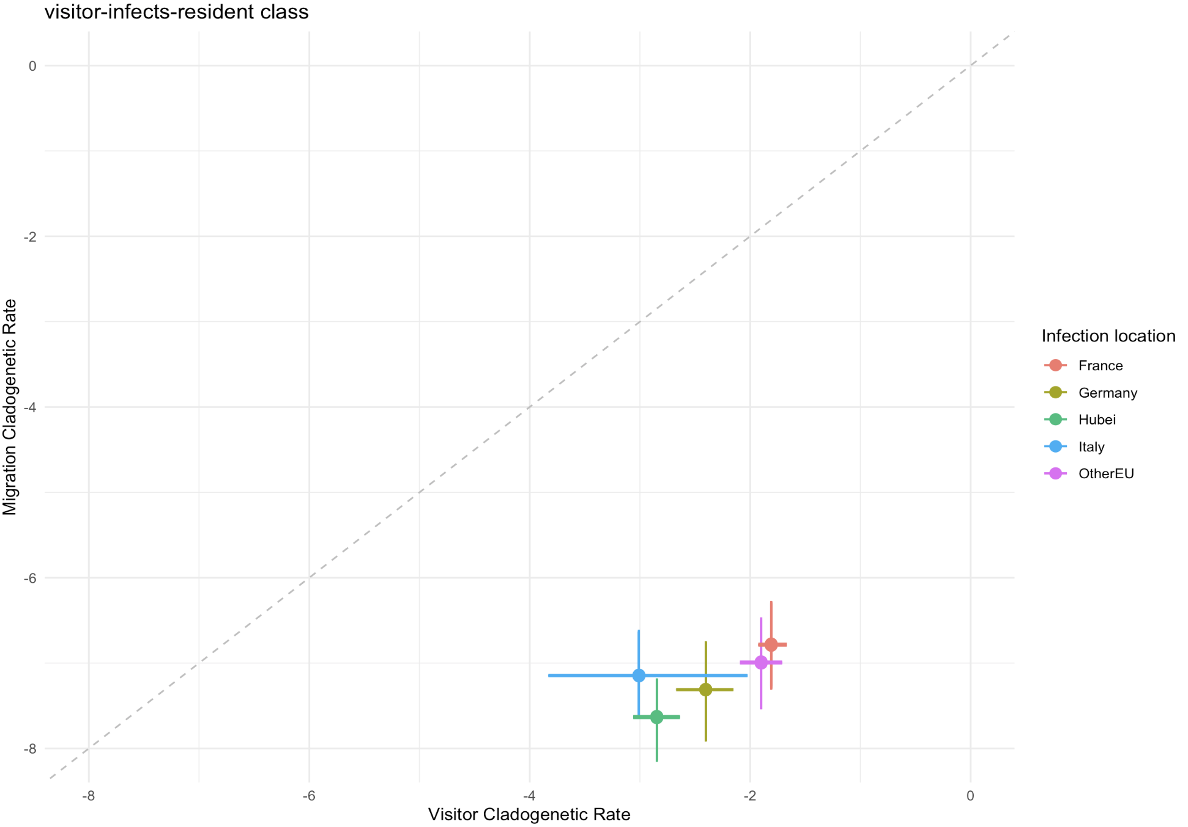
Unequal rates model (new priors on sampling proportions and empirical priors) – with burn-in on visitor – fewer mixing problem
Notes:
Two visitor events have rates >> 0.005

Slide 16
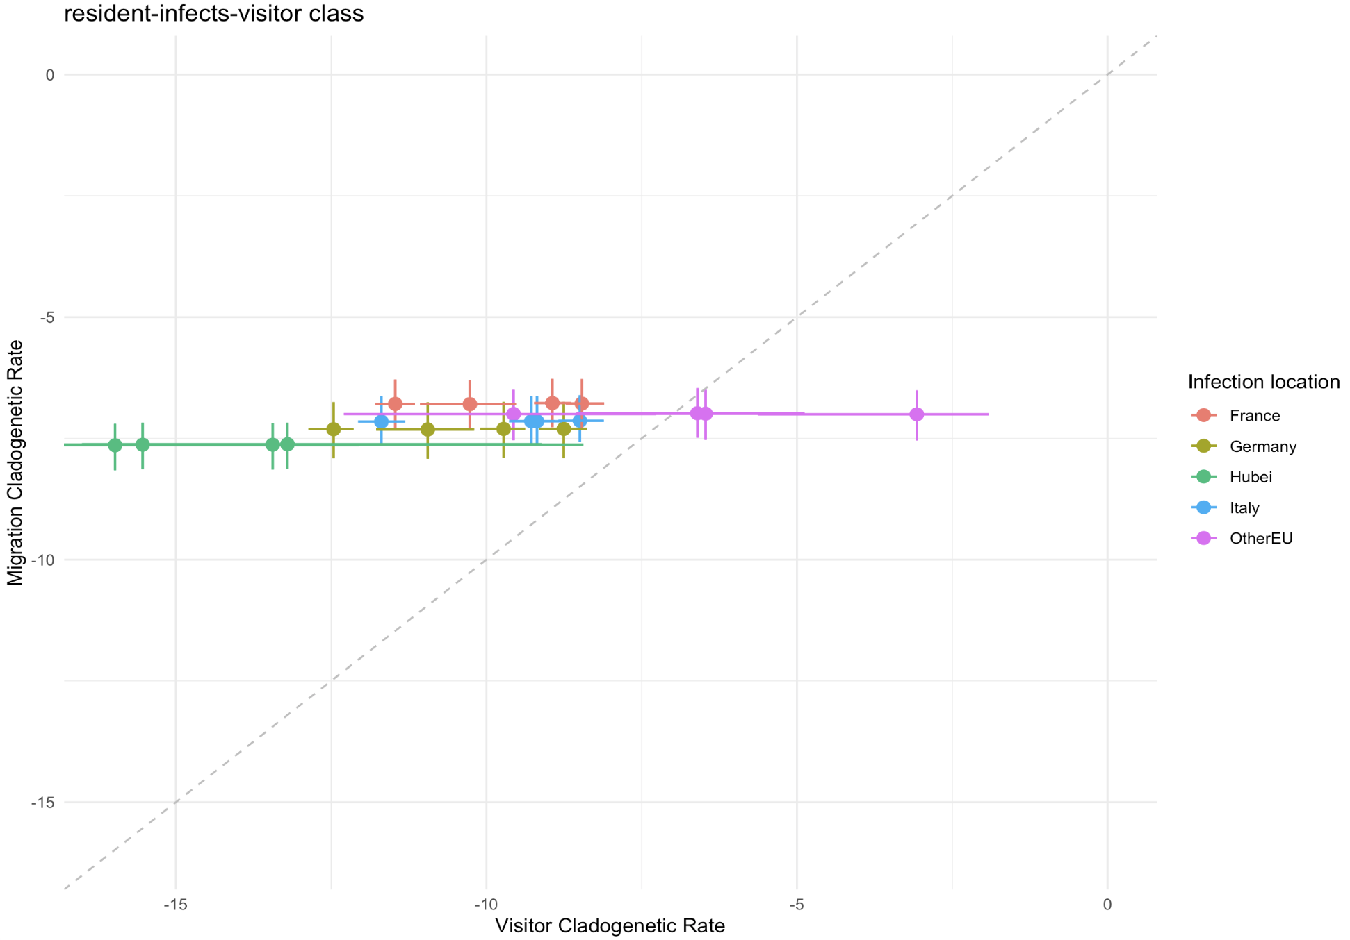
Unequal rates model (new priors on sampling proportions and empirical priors) – with burn-in on visitor – fewer mixing problem

Slide 17
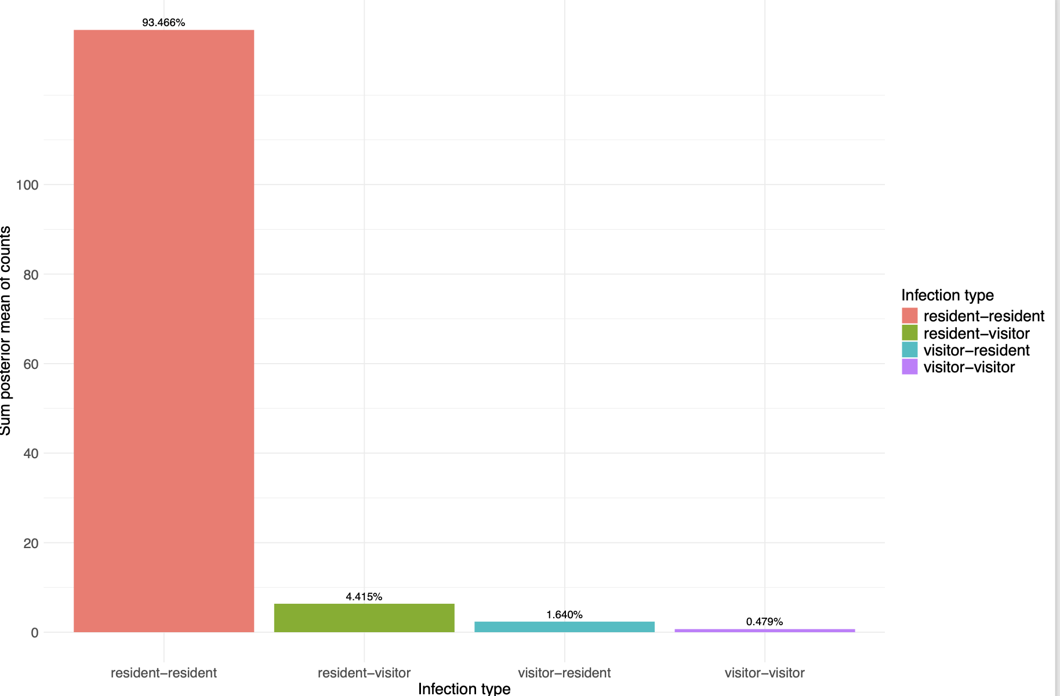
Unequal rates model (new priors on sampling proportions and empirical priors) – with burn-in on visitor – fewer mixing
Notes:
Two visitor events have rates >> 0.005

Slide 18
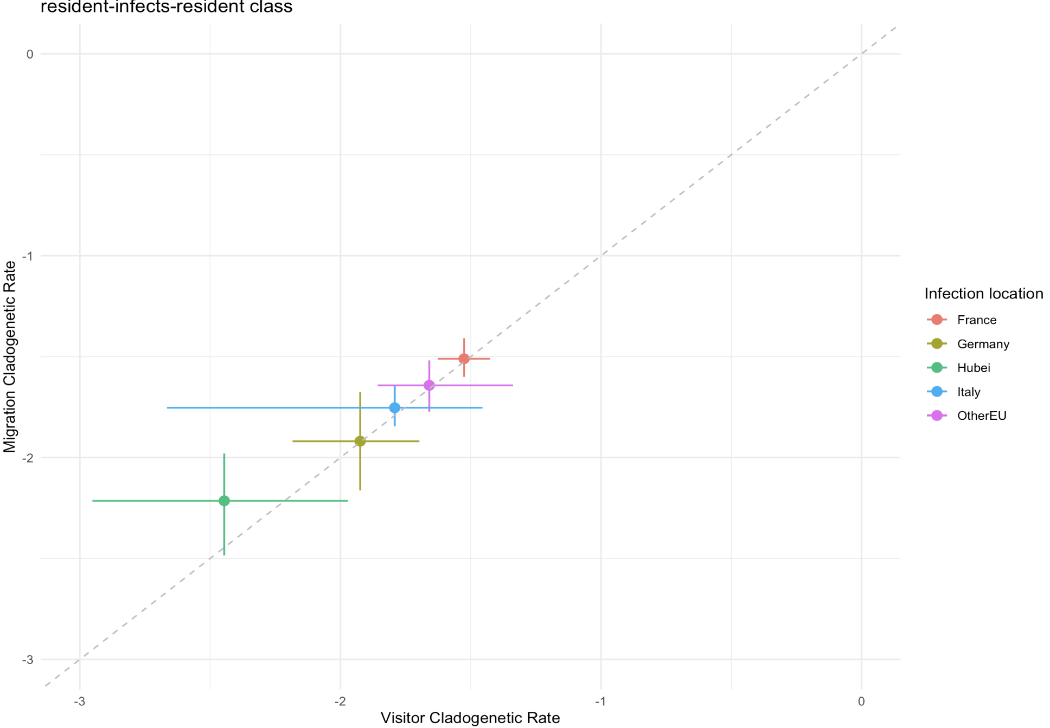
Unequal rates model – fixed sampling

Slide 19
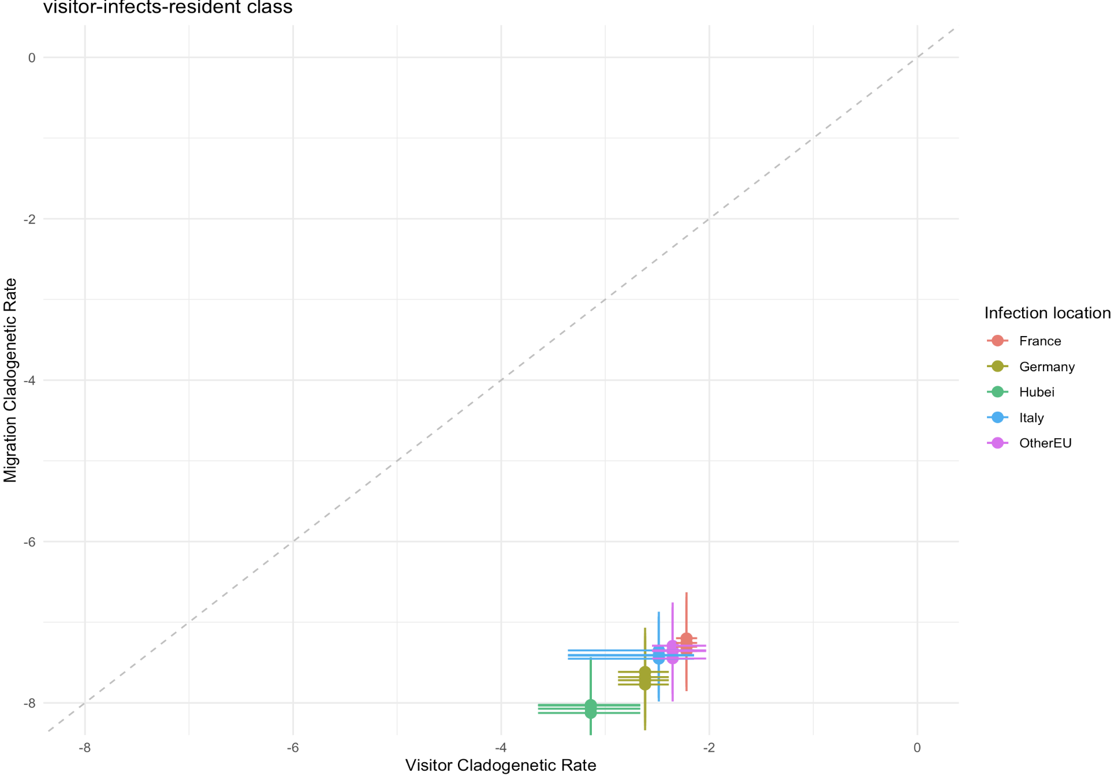
Unequal rates model – fixed sampling

Slide 20
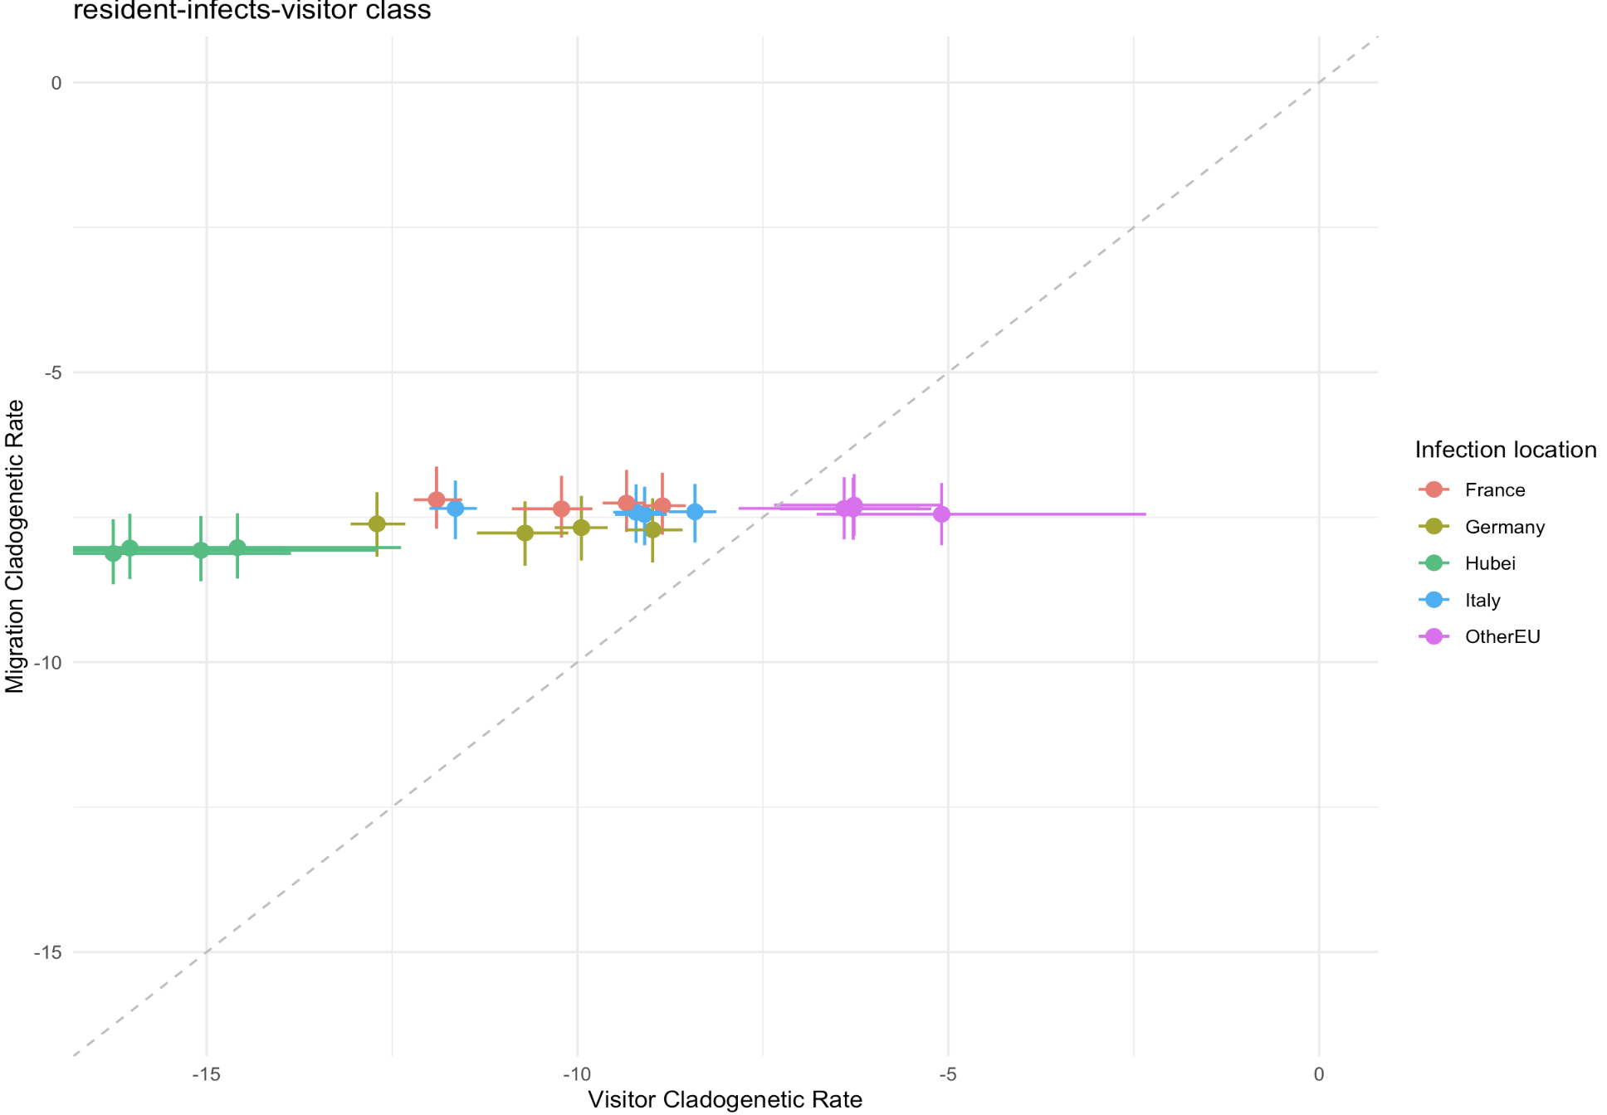
Unequal rates model – fixed sampling

Slide 21
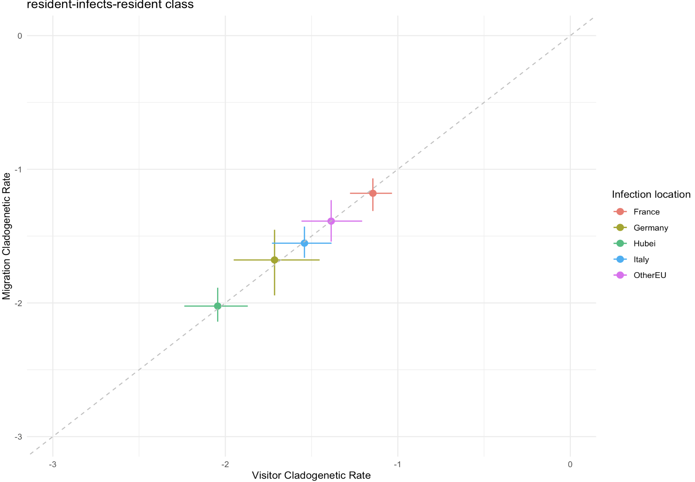
Unequal rates model – movement rates independent of away locations

Slide 22
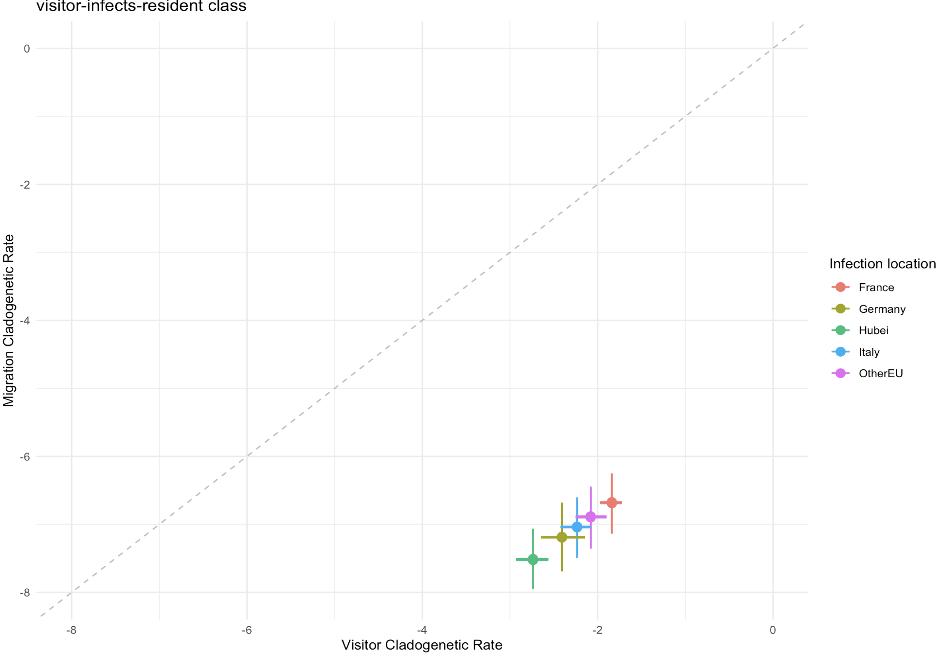
Unequal rates model – movement rates independent of away locations

Slide 23
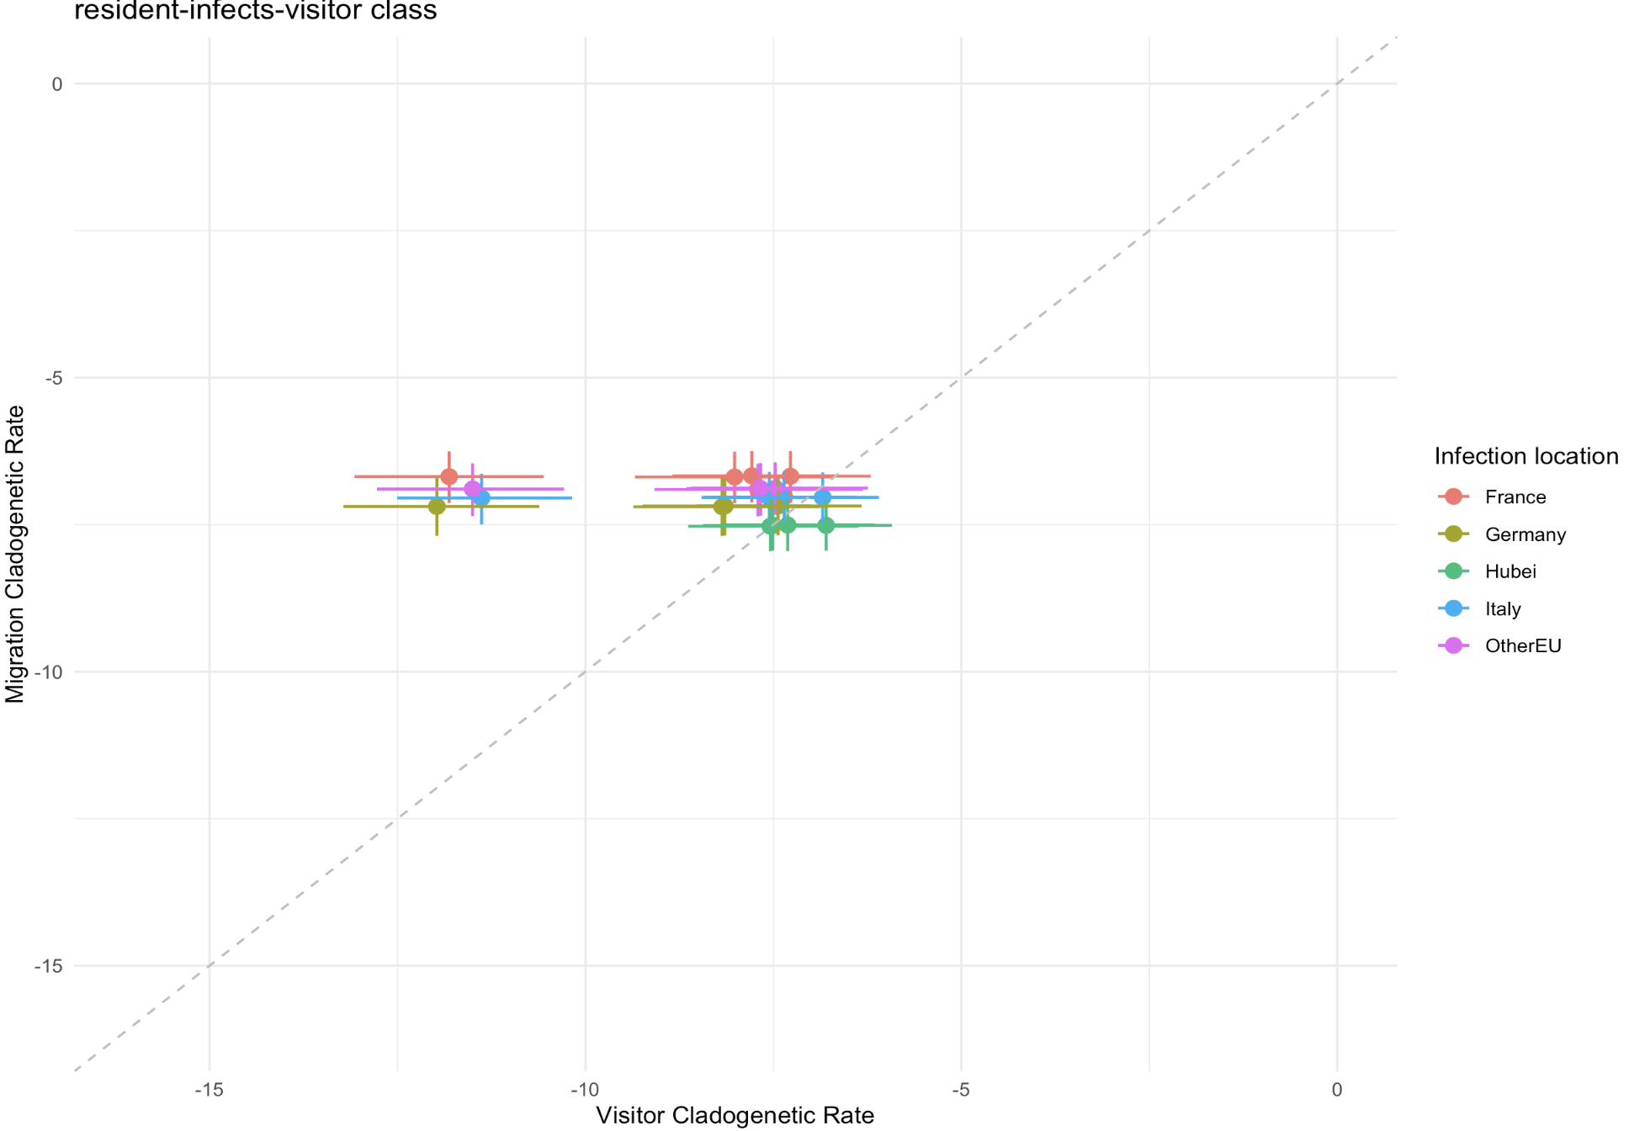
Unequal rates model – movement rates independent of away locations

Slide 24
Summary
Loc | Visit_equal_old_priors | Visit_equal_new_priors | Visit_unequal_new_priors | Visit_unequal_new_priors_fixed_sampling | Visit_unequal_new_priors_burnin | Visit_unequal_new_priors_away_indep | Visit_unequal_new_priors_4x | Visit_unequal_new_priors_40x
Hubei | 1.287 | 1.335 | 1.091 | 0.778 | 1.095 | 1.257 | 1.166 | 1.394
France | 3.1 | 3.202 | 3.276 | 2.026 | 3.298 | 3.225 | 1.387 | 4.108
Germany | 1.83 | 1.866 | 1.813 | 1.361 | 1.799 | 1.808 | 2.071 | 1.89
Italy | 2.064 | 2.248 | 1.86 | 1.95 | 1.843 | 2.181 | 2.452 | 3.097
OtherEU | 2.5 | 2.587 | 2.915 | 1.829 | 2.969 | 2.582 | 4.055 | 3.717
Red > blue > orange > green > black
Loc | Clado_equal_old_priors | Clado_equal_new_priors | Clado_unequal_new_priors | Clado_unequal_new_priors_fixed_sampling | Clado_unequal_new_priors_burnin | Clado_unequal_new_priors_away_indep | Clado_unequal_new_priors_4x | Clado_unequal_new_priors_40x
Hubei | 1.281 | 1.34 | 1.354 | 0.96 | 1.349 | 1.36 | - | -
France | 3.106 | 3.138 | 3.146 | 2.058 | 3.147 | 3.132 | - | -
Germany | 1.816 | 1.887 | 1.859 | 1.37 | 1.882 | 1.902 | - | -
Italy | 2.049 | 2.196 | 2.181 | 1.771 | 2.181 | 2.184 | - | -
OtherEU | 2.488 | 2.526 | 2.554 | 1.876 | 2.564 | 2.546 | - | -

Slide 25
Summary
Loc | Visit_equal_old_priors (sampling rate) | Visit_equal_new_priors | Visit_unequal_new_priors | Visit_unequal_new_priors_fixed_sampling | Visit_unequal_new_priors_burnin | Visit_unequal_new_priors_away_indep | Visit_unequal_new_priors_4x | Visit_unequal_new_priors_40x
Hubei | 1.44E-3 | 9.757E-3 | 6.309E-2 | - | 6.241E-2 | 3.209E-2 | 2.698E-2 | 3.137E-3
France | 1.673E-3 | 1.345E-2 | 1.146E-2 | - | 1.109E-2 | 1.288E-2 | 1.457E-2 | 1.94E-3
Germany | 2.653E-3 | 2.882E-2 | 3.085E-2 | - | 3.233E-2 | 3.104E-2 | 1.496E-2 | 1.632E-3
Italy | 5.995E-4 | 2.708E-3 | 1.894E-3 | - | 1.915E-3 | 2.517E-3 | 7.153E-4 | 8.078E-5
OtherEU | 1.835E-3 | 1.607E-2 | 1.481E-2 | - | 1.435E-2 | 1.417E-2 | 3.147E-3 | 1.22E-3
Red > blue > orange > green > black
Priors: Hubei > Germany > France >> OtherEU >> Italy
Loc | Clado_equal_old_priors (sampling rate) | Clado_equal_new_priors | Clado_unequal_new_priors | Clado_unequal_new_priors_fixed_sampling | Clado_unequal_new_priors_burnin | Clado_unequal_new_priors_away_indep | Clado_unequal_new_priors_4x | Clado_unequal_new_priors_40x
Hubei | 1.598E-3 | 9.49E-3 | 8.945E-3 | - | 9.091E-3 | 8.422E-3 | - | -
France | 1.673E-3 | 1.56E-2 | 1.583E-2 | - | 1.561E-2 | 1.612E-2 | - | -
Germany | 2.586E-3 | 2.386E-2 | 2.577E-2 | - | 2.49E-2 | 2.256E-2 | - | -
Italy | 6.229E-4 | 3.177E-3 | 3.322E-3 | - | 3.281E-3 | 3.377E-3 | - | -
OtherEU | 1.897E-3 | 1.748E-2 | 1.553E-2 | - | 1.539E-2 | 1.692E-2 | - | -
Pretty much similar across different setups

